Slide 1

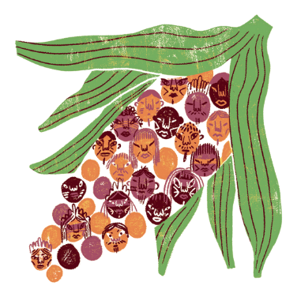


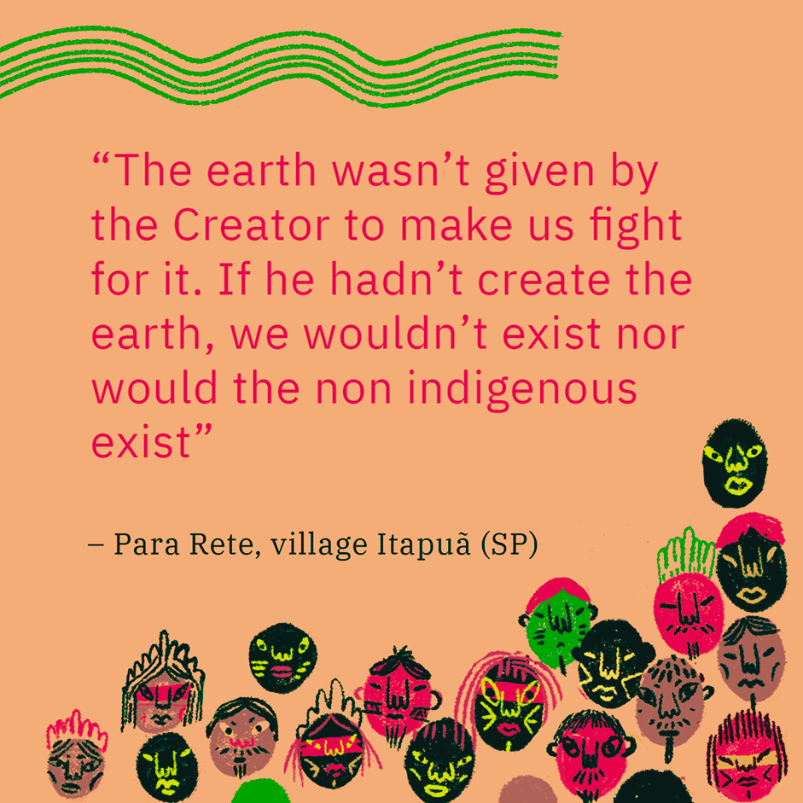






THE GUARANI
Notes:
Prior to the lesson you will need to print off the resource pack
Hand out just the photographs first to stimulate discussion and questions.

Slide 2











Lesson 1
Where do you think the picture was taken?Why?
What can you see?
Activity 1
Look carefully at each picture in your pack and discuss these questions
What is interesting about the photograph?
What is similar or different to Wales?
Notes:
Hand out just the photographs first to stimulate discussion and questions.

Slide 3

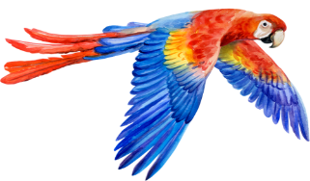
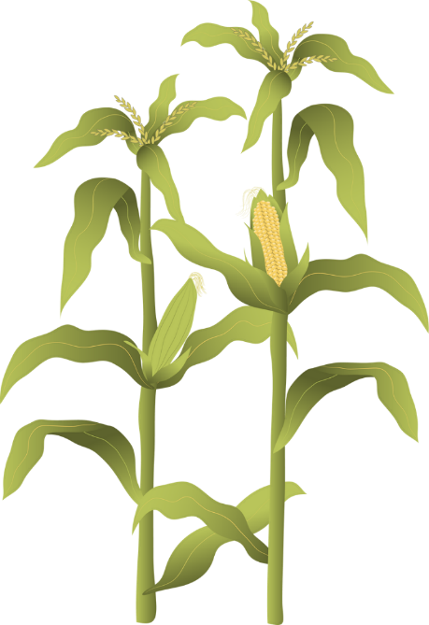


Activity 2
Next read the captions carefully and match them to the correct picture
Notes:
Hand out the captions. Once pupils have matched the captions, display the resource pack on the board and discuss the pictures and what is

Slide 4






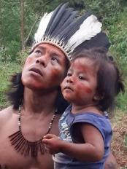





Where do the Guarani live?
The Atlantic Forest, Brazil
Notes:
The Guarani live primarily in the Atlantic Forest of Brazil, as well as Argentina, Paraguay and Bolivia.

Slide 5

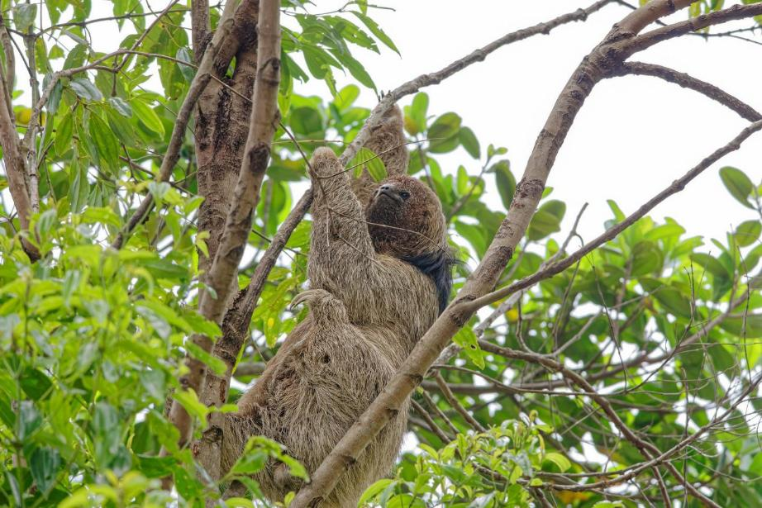
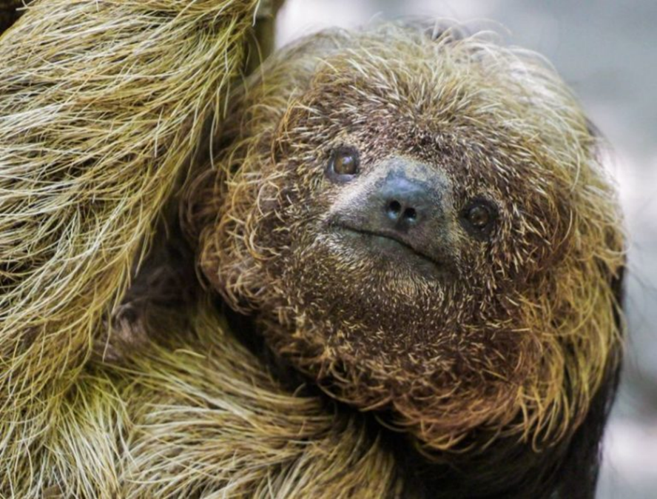
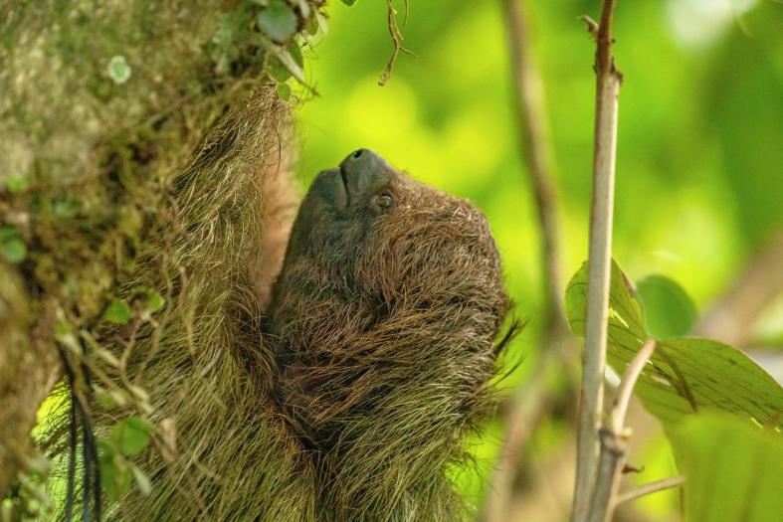
Who
am I?
Notes:
Maned sloth: A species of three-toed sloth endemic (only found) in the Mata Atlântica, so named because of its long hair.
Algae, mites, ticks, beetles, and moths live among their thick fur. The greenish tint created by the algae serves as camouflage in the jungle canopy.
Due to continued habitat loss, the maned sloth is considered Endangered.

Slide 6
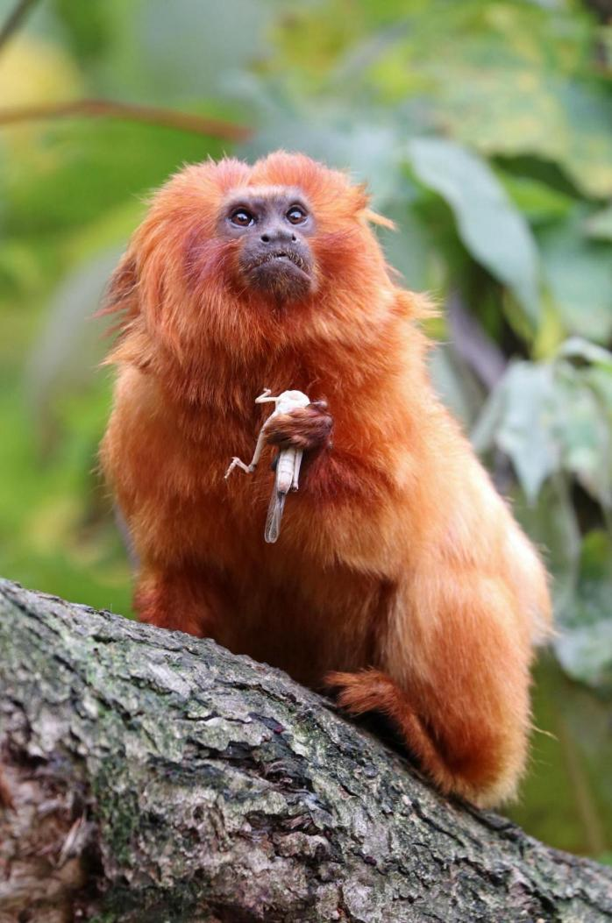
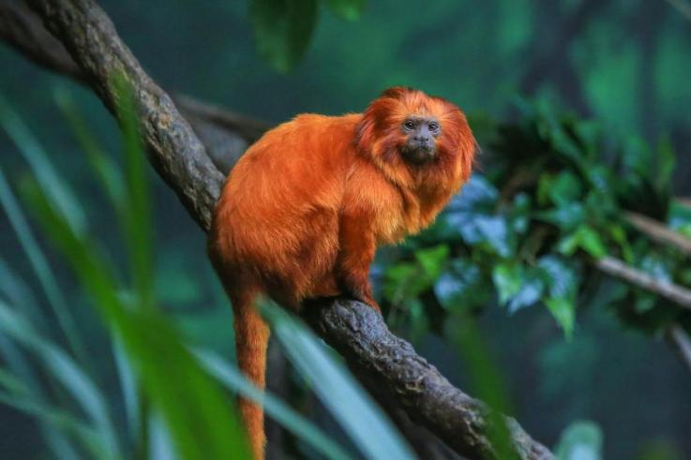
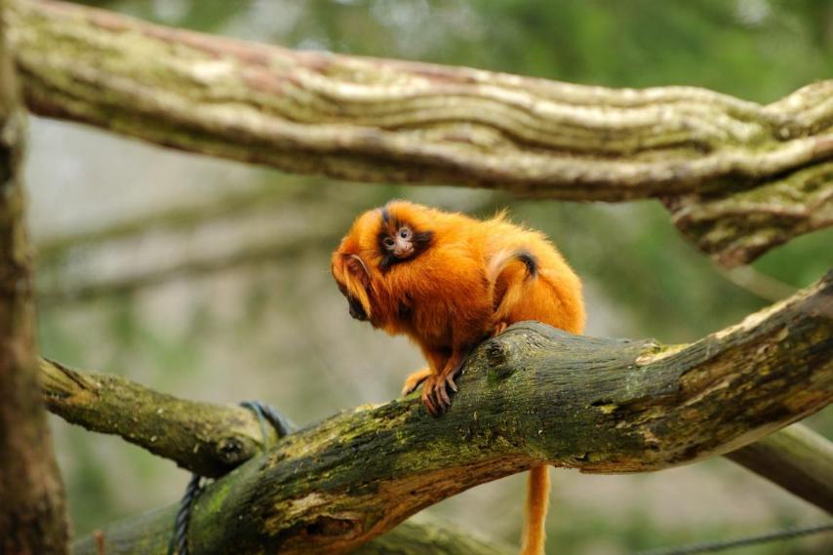
Who
am I?
Notes:
These are primates called Golden Lion Tamarins. Why do you think they’re called this? Yes for their golden manes.
The golden lion tamarin forms social family groups. Males help to raise their offspring, and often carry their young on their backs in between feedings. Tamarin young are usually twins. Golden lions live primarily in the trees. They sleep in hollows at night and forage by day while traveling from branch to branch. Long fingers help them stay aloft and snare insects, fruit, lizards, and birds.

Slide 7
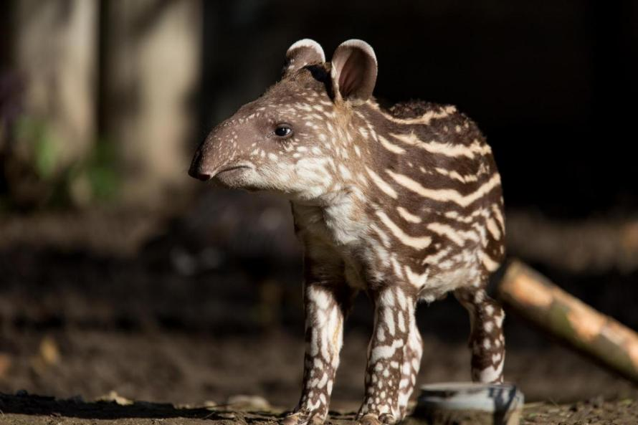
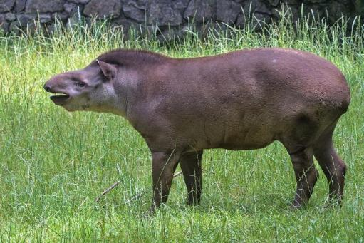
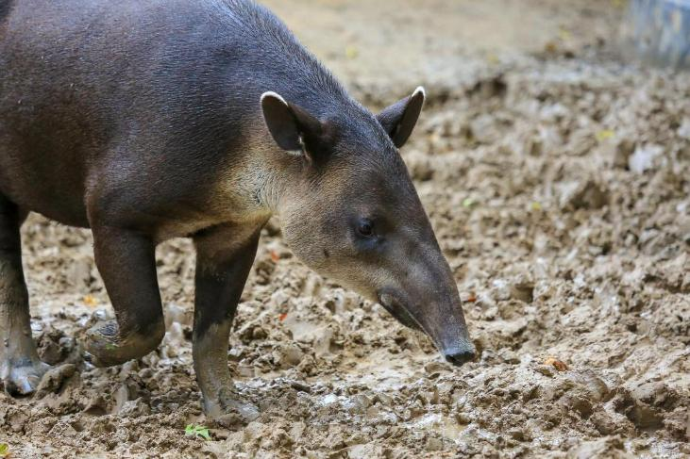
Who
am I?
Notes:
Tapirs are South America’s largest native land mammal.
The tapir is an intelligent animal with a high concentration of neurons, similar to the elephant.
It helps maintain biodiversity (lots of different types of animals and plants) by spreading seeds through its poo, earning them the name “Gardener of the Atlantic Forest”

Slide 8
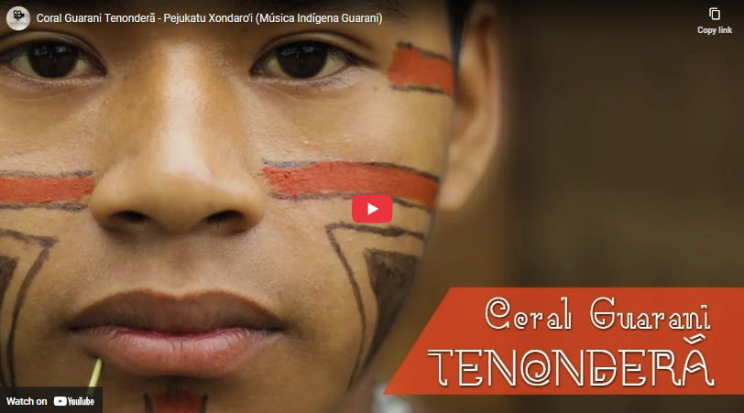
https://www.youtube.com/watch?v=TeuEVej1RGI
Notes:
The Tenonderã Guarani Choir is a musical group that performs traditional songs of the Guarani
https://www.youtube.com/watch?v=TeuEVej1RGI

Slide 9

Learning check
  Which forest do the Guarani protect?
  Can you name some animals that live here?
  What does “food sovereignty” mean?
  What percentage of the Atlantic forest is left?

Slide 10



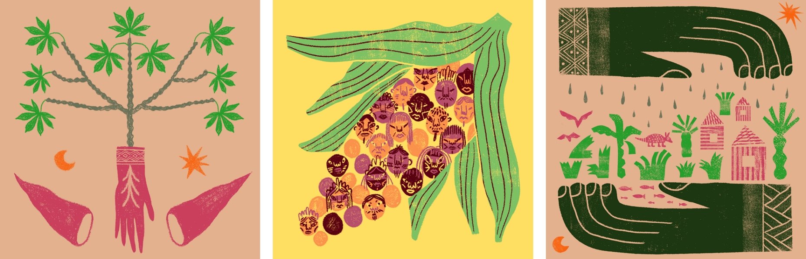

Lesson 2
What do you think it might mean?
What can you see?
Look at the Guarani artwork
Guarani Artwork
Notes:
*You will need to print out the soy suspects cards to use in this lesson.
Use the artwork and questions to stimulate discussion. How does it make them feel?
Explain we'll revisit the pictures later.

Slide 11
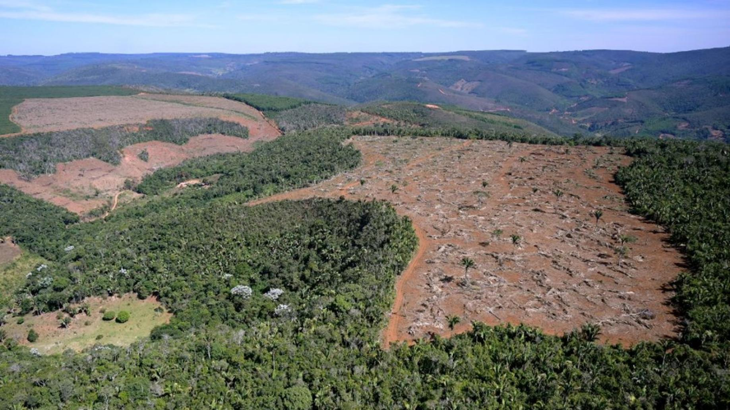




What is happening here?
Notes:
What is happening here? (Deforestation)
What effect will this have on the Guarani people and their way of life?
What about the wildlife of the Atlantic Forest?
Why do you think this is happening?
An area of rainforest has been cleared to grow Soy.

Slide 12
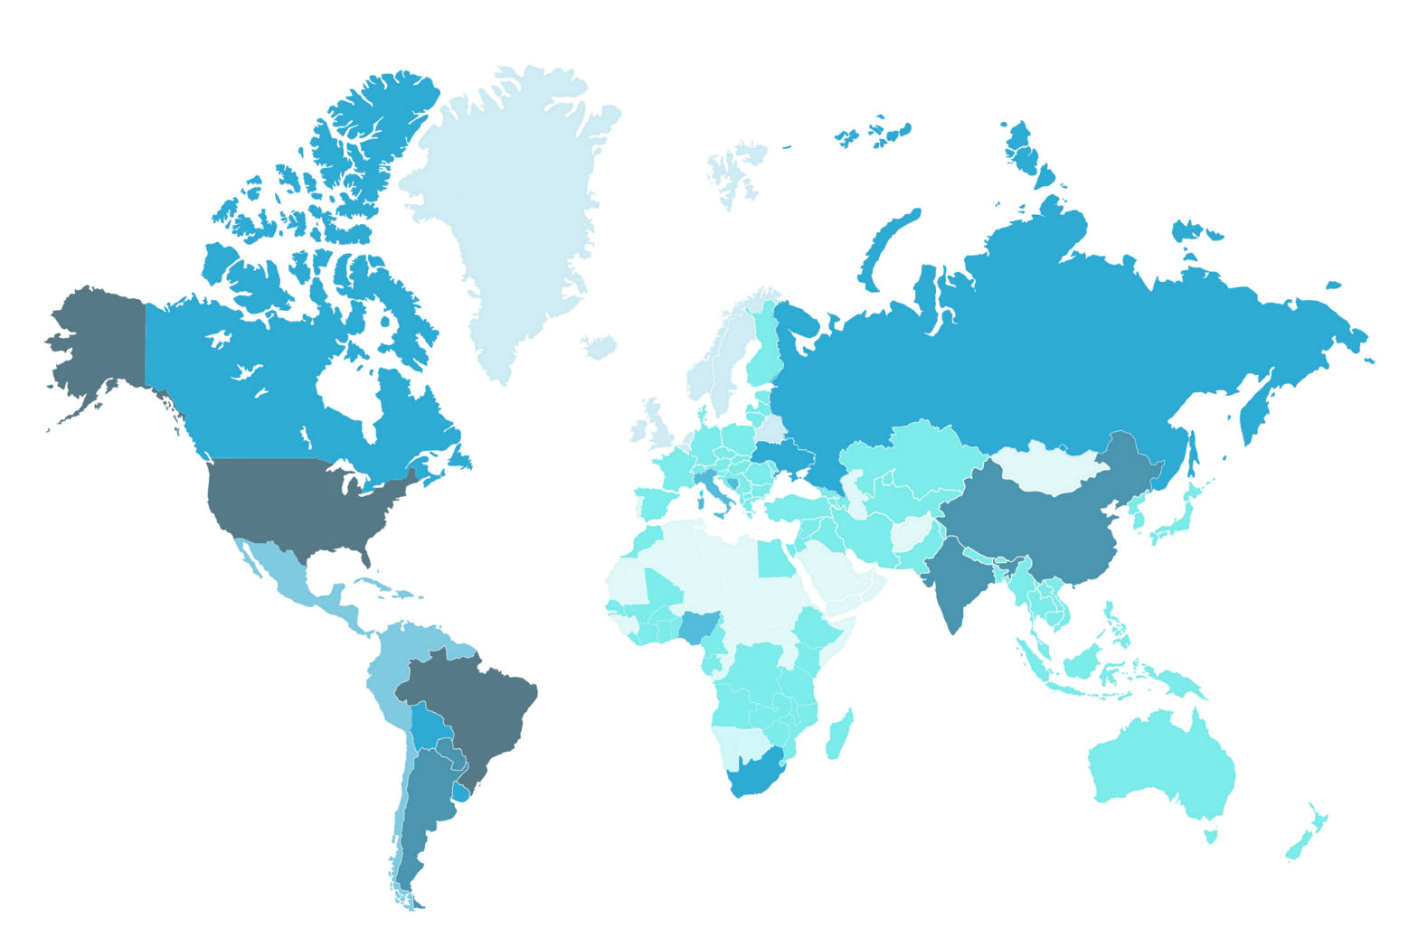

GREENLAND
CANADA
RUSSIA
Most soy
CYMRU
KAZAKHSTAN
TURKEY
CHINA
USA
MOROCCO
COTE
D’ IVORE
INDIA
BRAZIL
AUSTRALIA
ARGENTINA
Least soy
Notes:
This Map shows the growth of Soy Globally

Slide 13

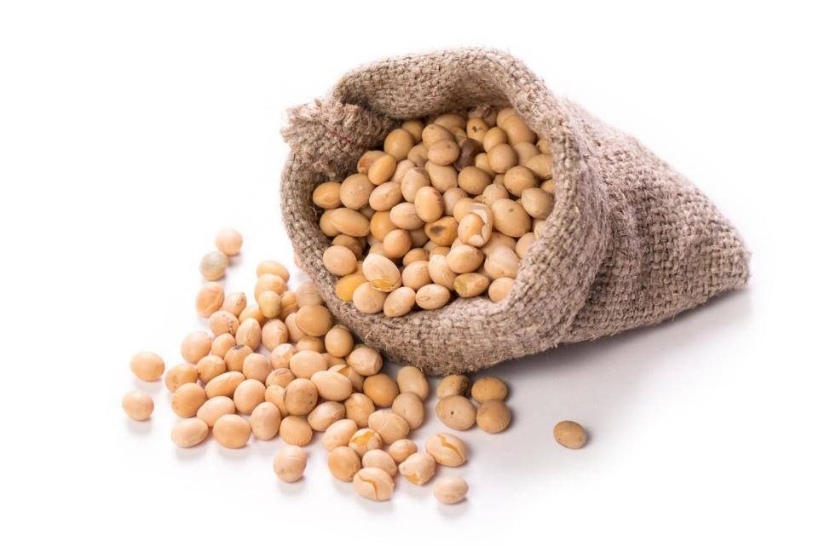

What do we use soy beans for?
Notes:
Ideas from the class.
We will find out more in the following slides

Slide 14


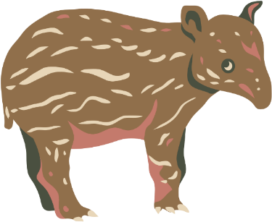
Activity Time:
SOY SUSPECTS
Which character
is eating or using
the most soy?

Slide 15
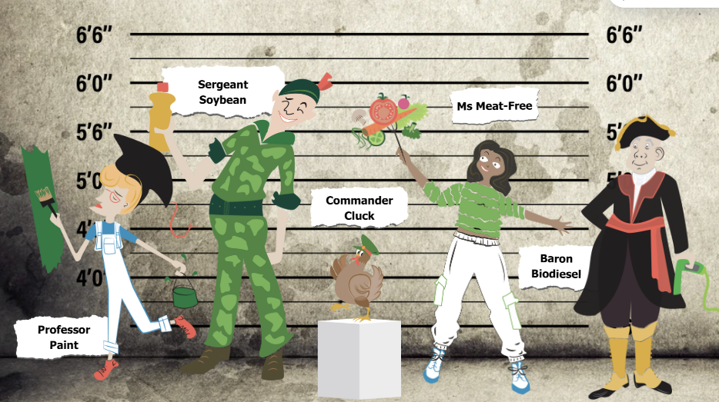
Notes:
Give out the soy suspects cards for children to read and discuss in groups.
They must order them from least guilty to most guilty.

Slide 16
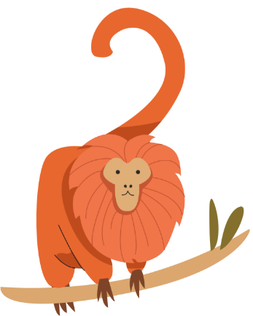
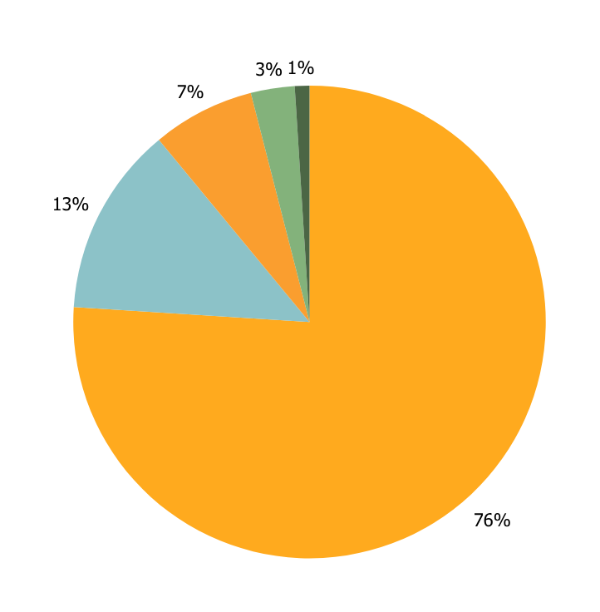

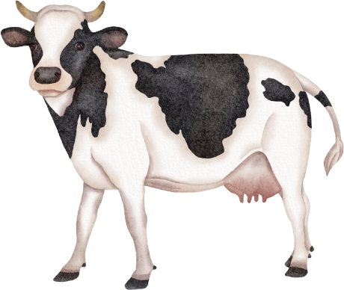
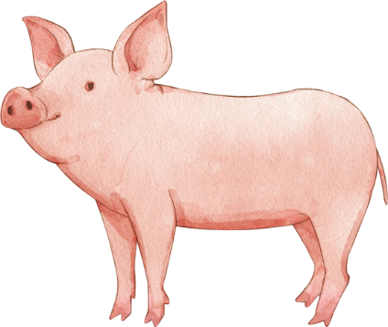
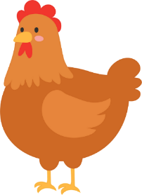
Results
76% - animal feed
It’s not vegetarians who eat the
most soy. It’s our farm animals!
13% - cooking oil
7% - human food
3% - biodiesel
1% - paint

Slide 17
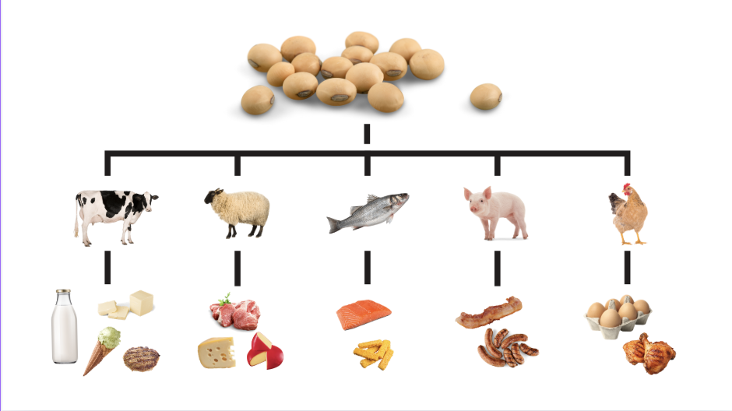

Embedded soy
Notes:
Have a look at the different animals and products. All these animals are fed on soy. Which products come from which animal? How might we be eating embedded soy if we were eating eggs for example? We don't directly eat the soy, but we could be eating eggs from chickens that have eaten soy.

Slide 18
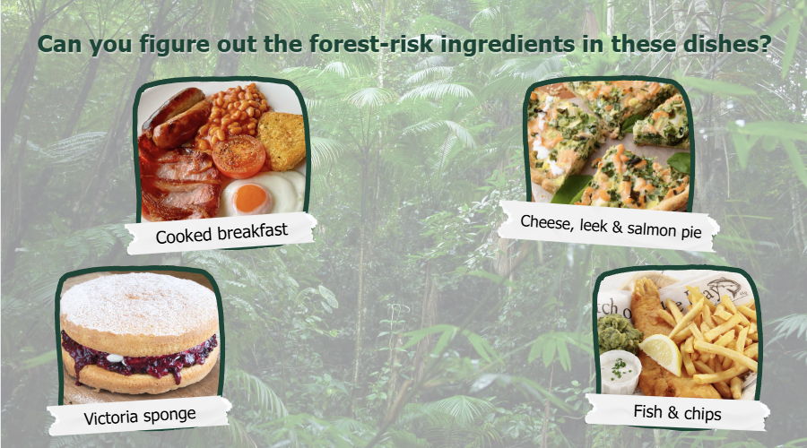
Notes:
Choose a meal and work out which ingredients may put tropical forests at risk of deforestation
eg- Sponge cake
Margarine
eggs
cream

Slide 19
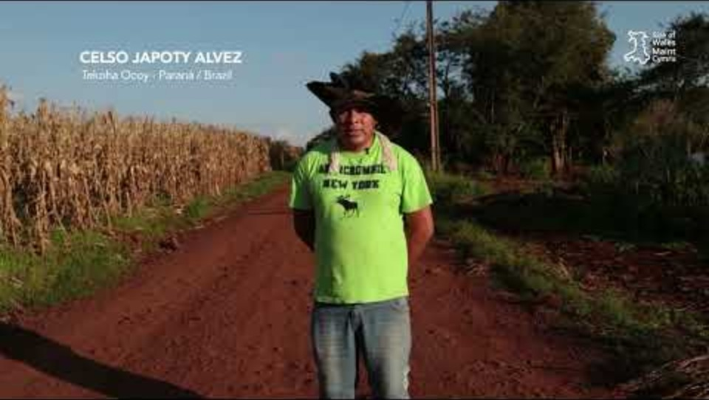

https://www.youtube.com/watch?v=59kaN18gXOE
Notes:
Video showing the life and challenges for the Guarani
https://www.youtube.com/watch?v=59kaN18gXOE

Slide 20
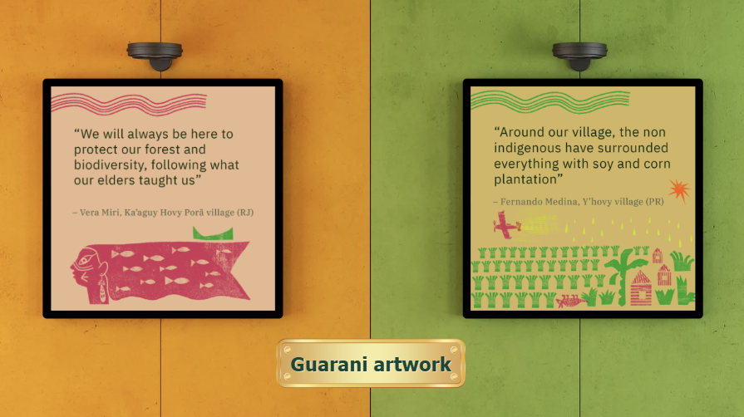
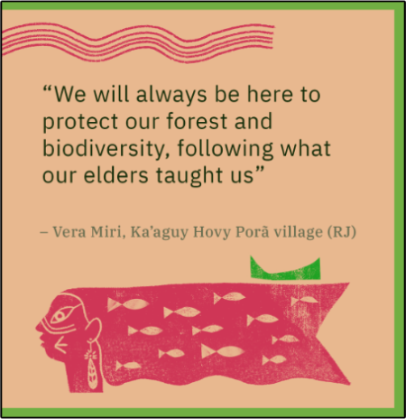
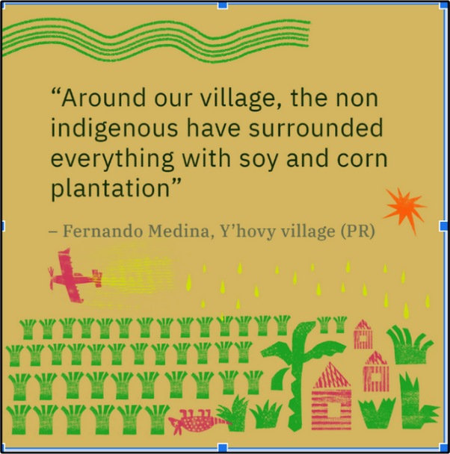
Notes:
Artwork by The Guarani
Ask the children what they can see in each picture, what might they symbolise and what do they think the messages mean. What might the yellow drops represent?
Answer: Pesticides.
Why have they printed fish in the person's hair?
Answer: They learn from their elders, and fish sustainably.

Slide 21

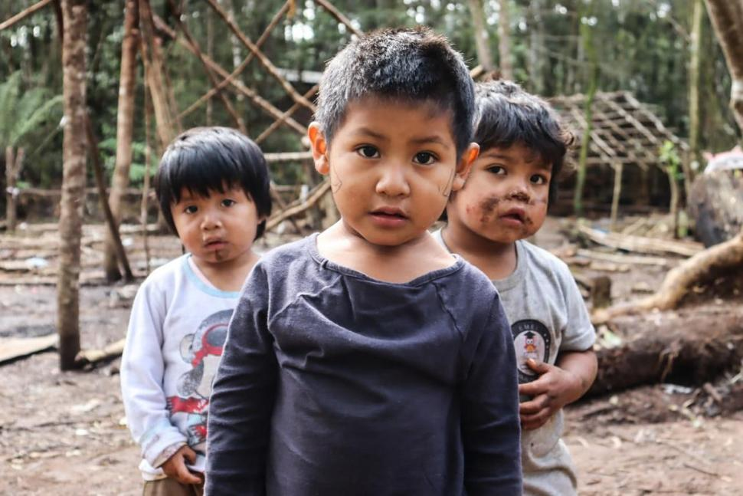
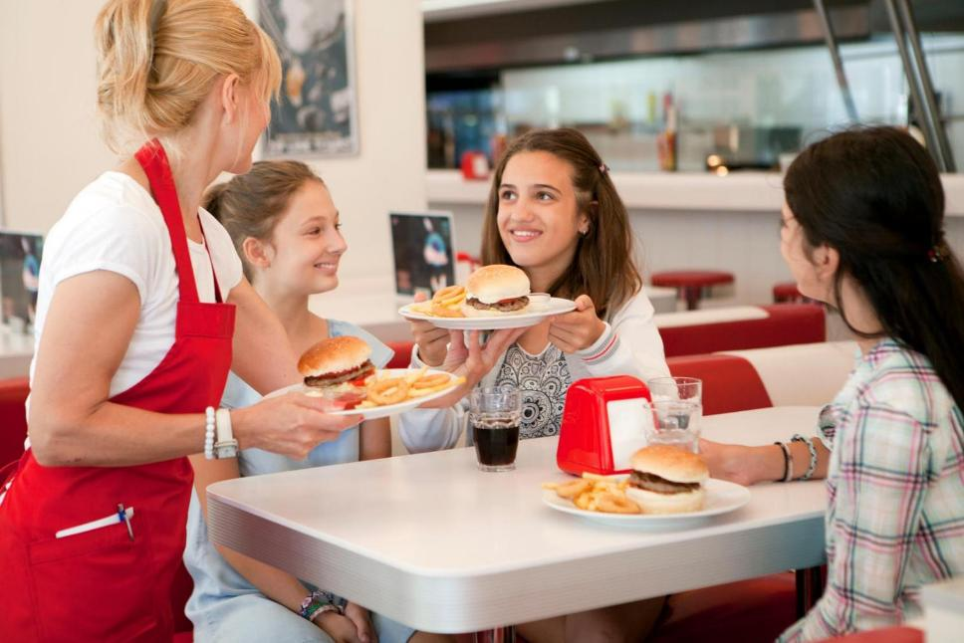


How is food in Wales connected to the Guarani in Brazil?

Slide 22

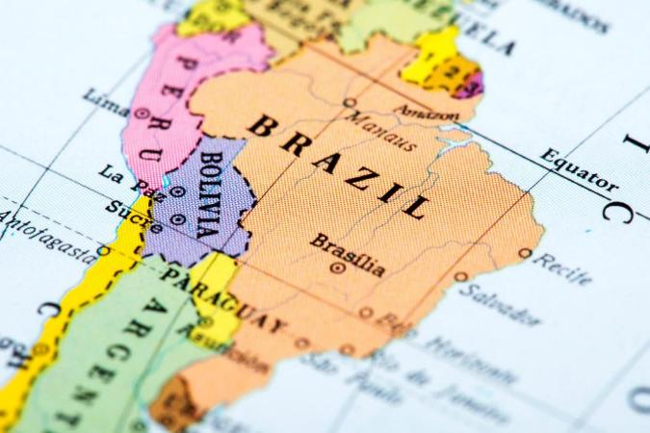
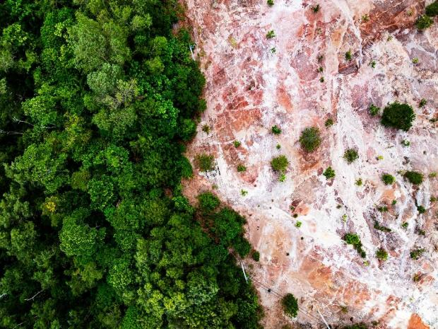
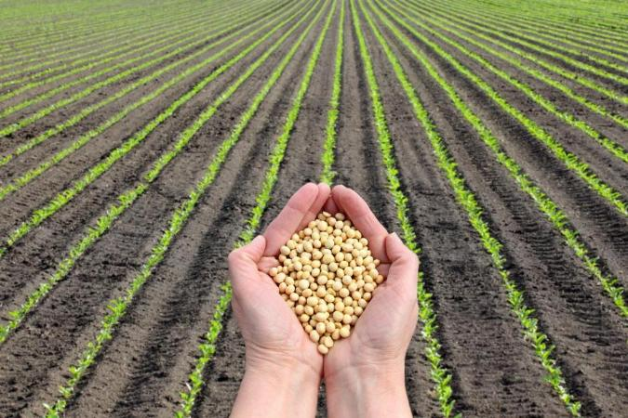


The Guarani people...
...live in the rainforests of Brazil...
...but their forest homes are being destroyed...
...to grow soy on the land...
Notes:
Follow the flow to make the connections

Slide 23
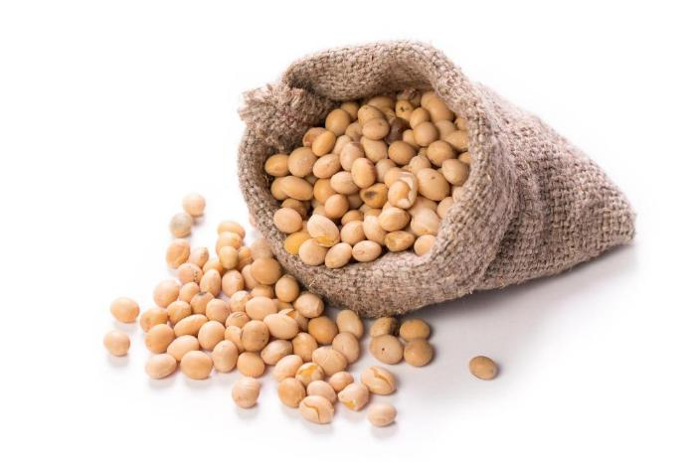
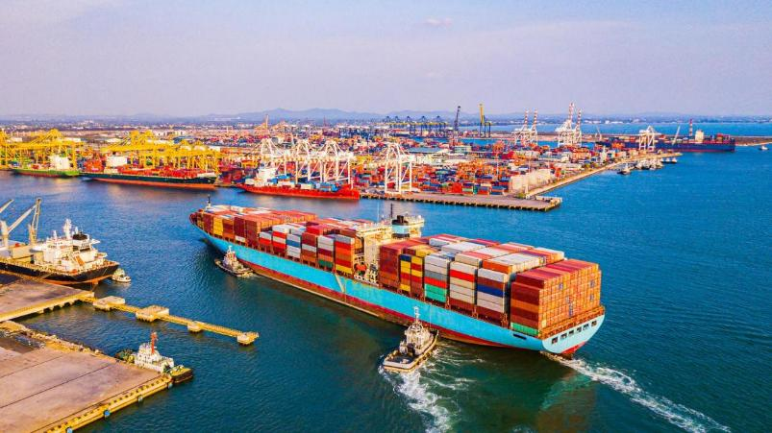
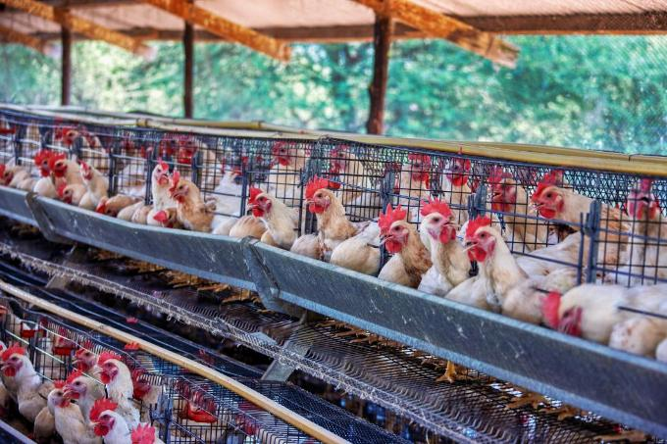
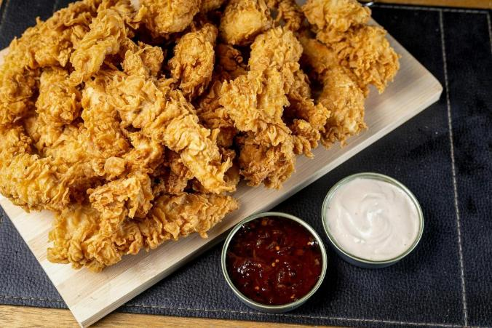

...that is sold around the world...
...and brought into Wales...
...to feed animals on our farms...
...that we love to eat!

Slide 24

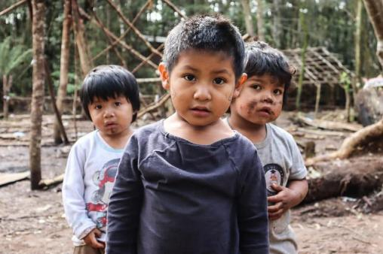







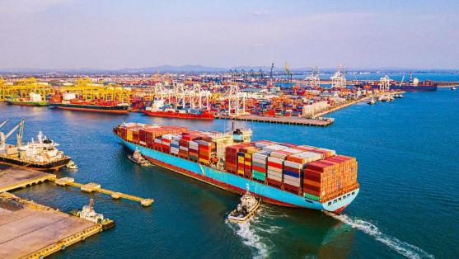


Now your turn! Can you tell the story of how the Guarani are connected to our food in Wales?
Notes:
Ask pupils to describe the connections themselves

Slide 25
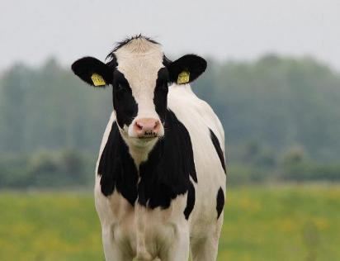
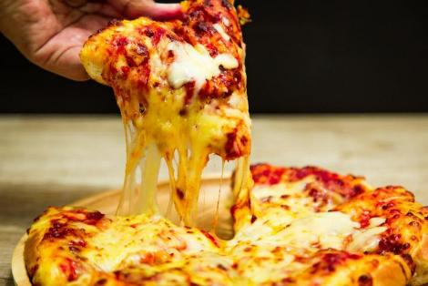
Well done! Now this time we have changed the ending- can you tell this story too?
Notes:
Ask pupils to describe the connections themselves/ notice the difference in this version
Note change of last 2 images
-Cattle fed on Soy
-embedded soy in the cheese

Slide 26
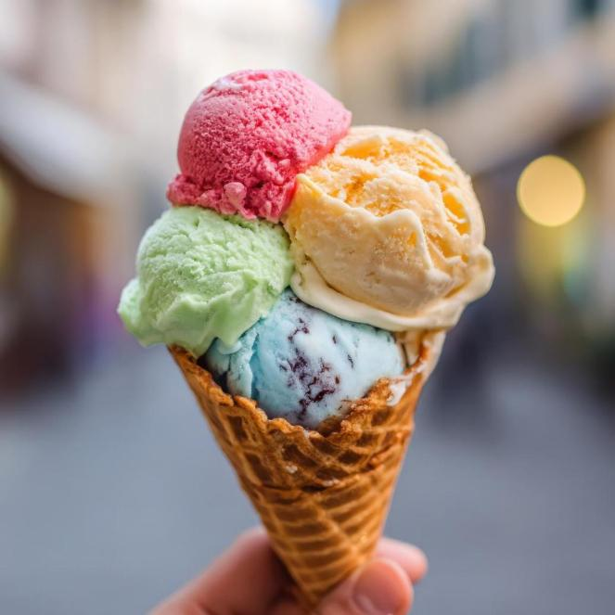
Challenge: Explain the links with no clues!

Slide 27
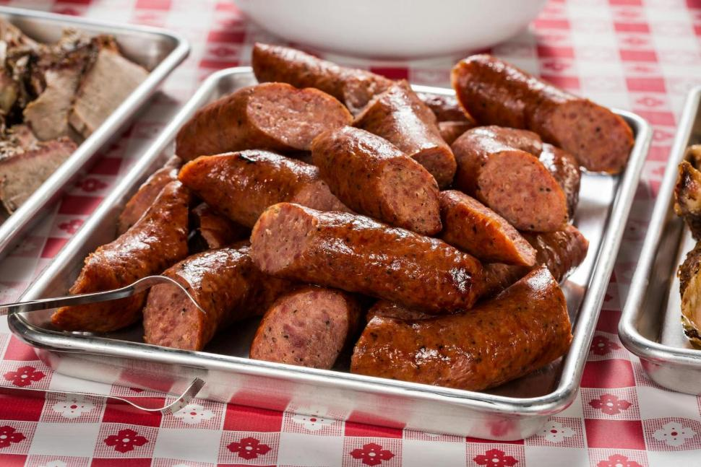
Well done! Now try this one!

Slide 28











What we can do in Wales to help
Eat more vegetables and pulses
Eat locally grown-
Pick your own!
Tell people about soy
Look out for these forest-friendly logos on packaging
Look for forest-risk ingredients on your school menu
Notes:
Discuss

Slide 29

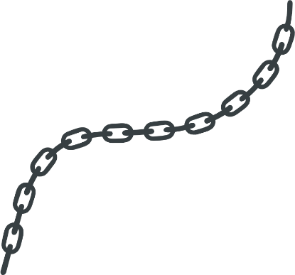

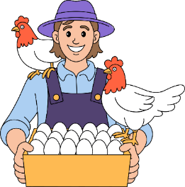


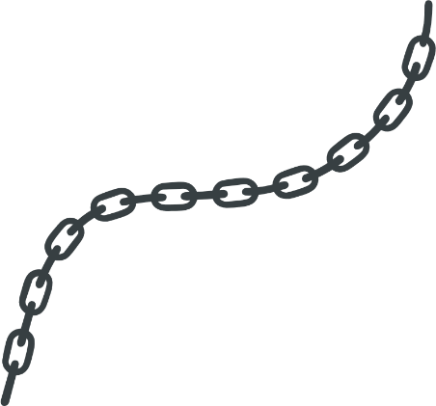



Who is connected in the food chain in Wales?
I farm chickens and supply their meat to the big food suppliers. I feed the chickens on soy as it is abundant and makes them bigger.
I am the catering manager at the council and we manage the meals services
in schools.
At Welsh Government, we provide the funding and set the guidelines for what young people should be eating in schools.
I am in charge of a big food supplier and we supply all the ingredients to schools.
I cook the meals in the schools
Notes:
All of these people/companies are part of the food chain in Wales and in your schools.

Slide 30





How can these people help make sure there is no tropical deforestation connected to our food in Wales?
School Cook
Senedd
Farmer
Food Supplier
Catering Manager
Notes:
Discuss
How they can help? Who can help the most/ who has the most power? What questions would you ask to each person?
You will have a chance to meet people from the supply chain at our Youth Cop event, so don't worry if you don't have all the answers, you can ask them.

Slide 31
Learning check
  Who or what eats most of the soy in Wales?
  List three things we can do in Wales to avoid embedded soy in our meals and help the Guarani?
  Who do we need to work together to make Wales deforestation free?

