Slide 1







COP 31

Slide 2

Lesson
We will be learning all about COP31 and why it is so important.

Slide 3

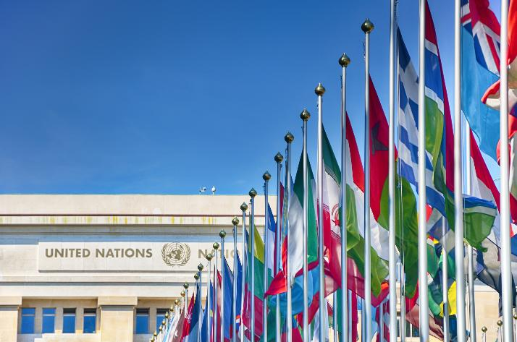
What is COP?
COP= conference of parties
  COP is a global meeting where world leaders come together to discuss environmental issues with the main focus on climate change. Their goal is to find global solutions to the problem.
  For 2026, it is called COP31, as this is the 31st conference since the COP was first held in 1995.
  The conference is run by the United Nations (UN). Does anyone know what that is?
Notes:
Answer to question:
The UN is an organisation of 193 countries from all around the world. The purpose of the UN is for countries to cooperate with each other to solve problems.

Slide 4

COP21- PARIS
In 2015, 195 countries came together to sign the Paris Agreement.
The Paris Agreement is a legally binding international treaty on climate change.
It’s primary aim is to limit global warming to no more than 2 degrees above pre-industrial levels and preferably 1.5 degrees.
Scientists have said keeping warming to below 1.5 degrees is critical to a healthy, safe planet.
Notes:
*'Pre-industrial' means before humans starting burning lots of fossil fuels and producting lots of greenhouse gases that are heating up our planet.
Humans starting using fossil fuels on a big scale during the industrial revolution. This is when humans starting emitting lots of greenhouse gases into the atmosphere.

Slide 5

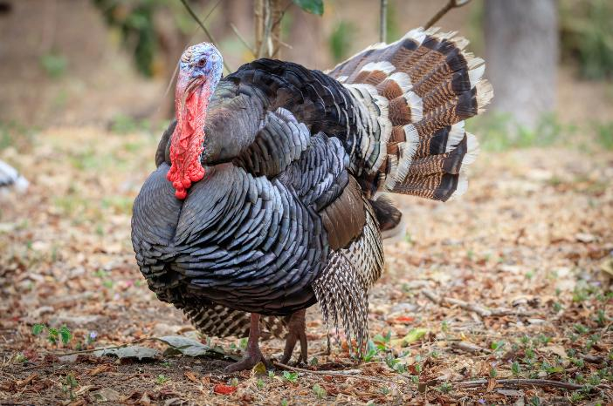

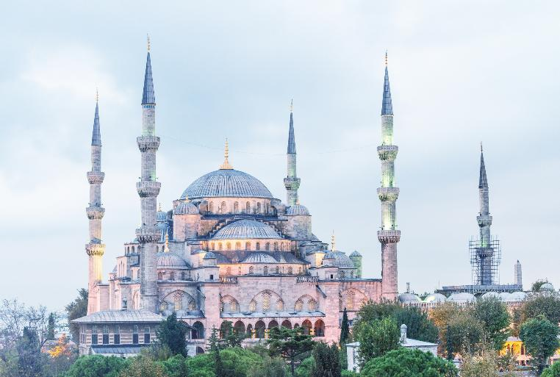
Where is it being held?
Can you guess?
What bird is this?
Country’s Flag
The Blue Mosque

Slide 6


Where is it being held?
COP31 will be held in Antalya. A city in the south of Turkey.

Slide 7

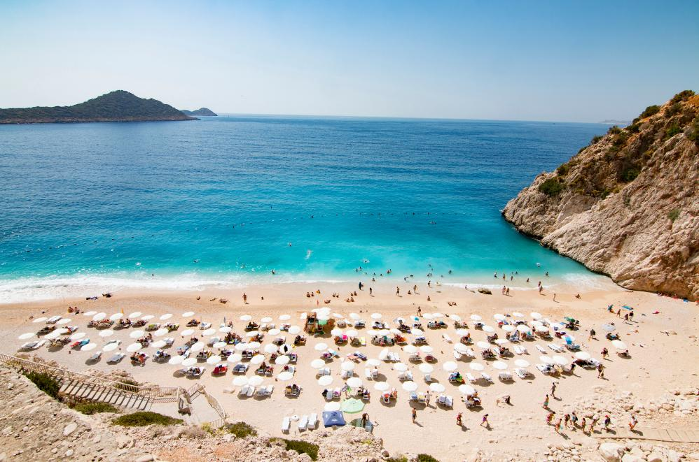
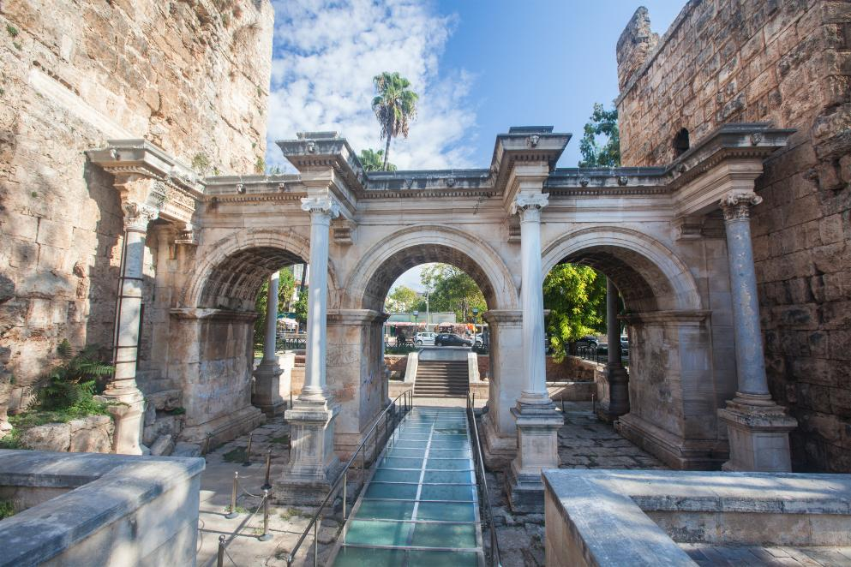

These are things found in Atalya, what do you notice?
Beautiful beaches
Unique dishes - this is
Piyaz
Historic ruins - this is Hadrian’s Gate

Slide 8
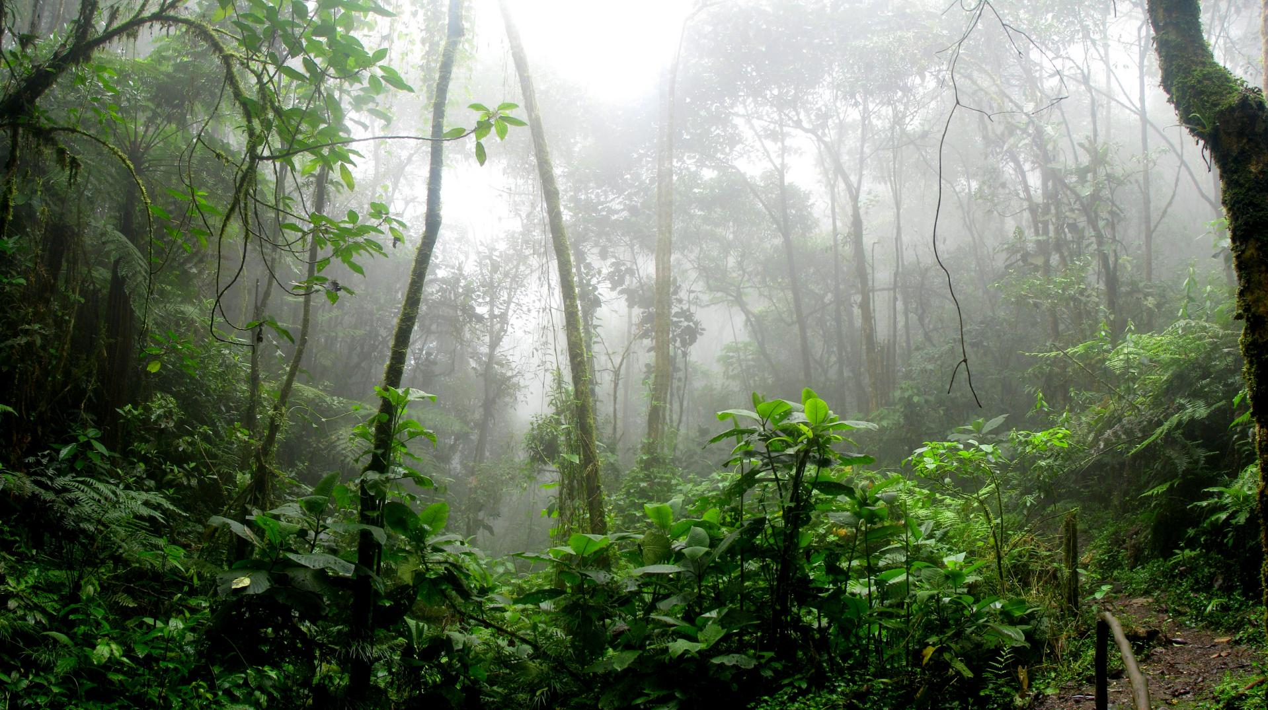
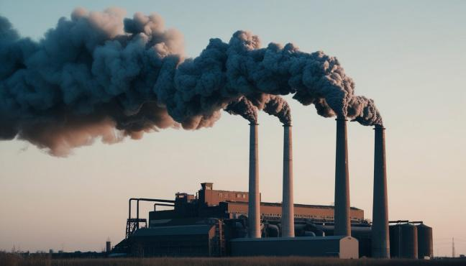
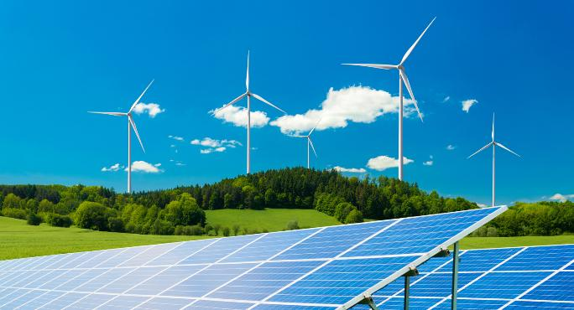
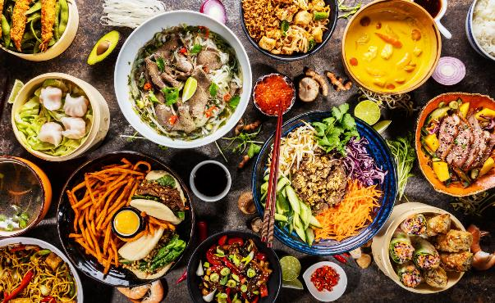
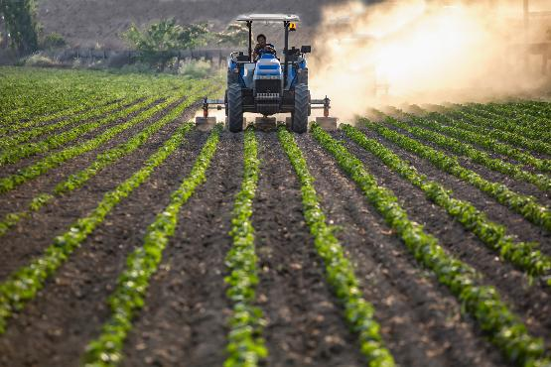
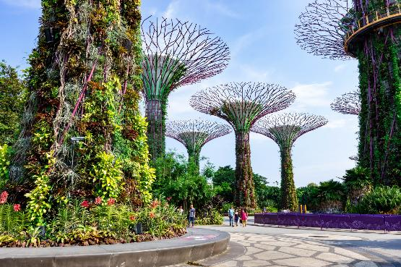
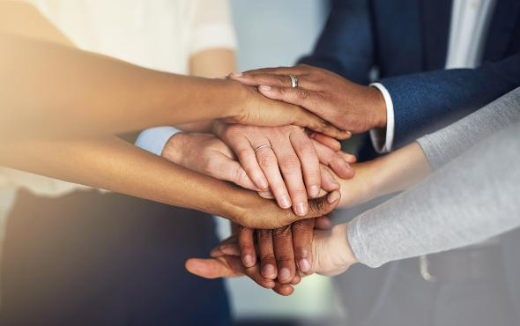

Clean energy transitions, improving energy security
Food security - supporting resilient farming systems
Emissions targets
COP31: Main themes
Resilient cities, infrastructure and water
Oceans and seas - strengthing its resilience
Youth engagement
Notes:
Across the 12 days, global leaders will come together to discuss these 6 main themes. They will come up with solutions and actions.

Slide 9

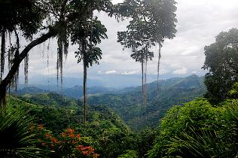
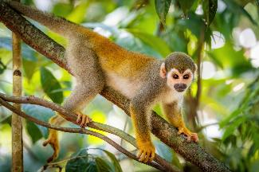
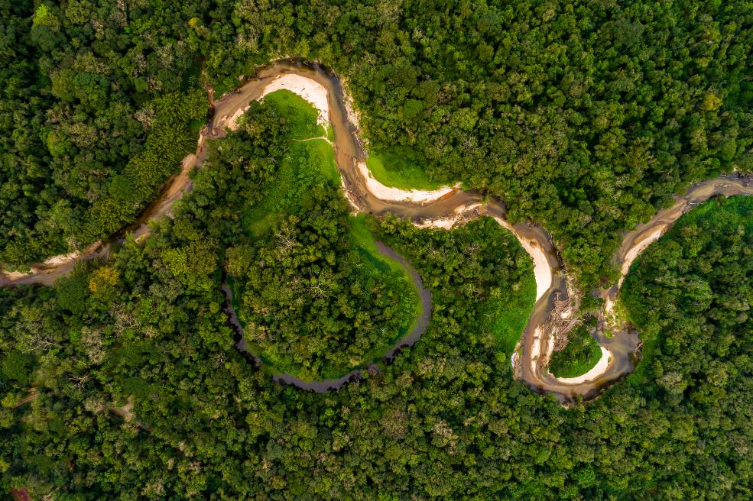
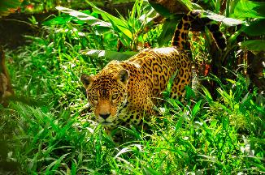
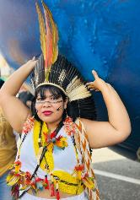

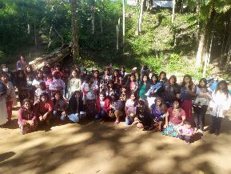
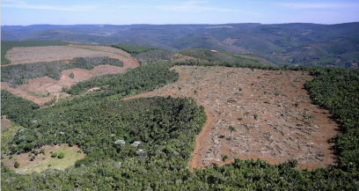
COP31: Continuing to fight for the Forest
After some of the members of the Guarani attend our Youth Cop Cymru they will be heading to COP 31 in Turkey.
They will be continuing to raise awareness around the protection of tropical forests, and their importance for our planet at the event.
Forests continue to be discussed as we reach closer to the target set for 2030. This target aims to ensure at least 140 countries commit to stopping and reversing deforestation of tropical forests by 2030.

Slide 10

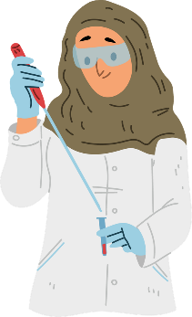
Who is attending?
Representatives from each country such as leaders, members of parliament and climate change experts attend the conference each year. It is an important event for sharing ideas and deciding on actions to take, as well as sharing the latest climate science research.
196 countries are involved in this annual conference. This is almost every country in the world!
Notes:
Wales cannot negotiate directly and does not have a seat at the table but is represented by the UK. Welsh Government officials attend to engage with other nations to take action.

Slide 11




Where has COP been held in the past?
Glasgow 2021
Paris 2015
Azerbaijan 2024
Egypt 2022
Dubai 2023
Brazil 2025

Slide 12
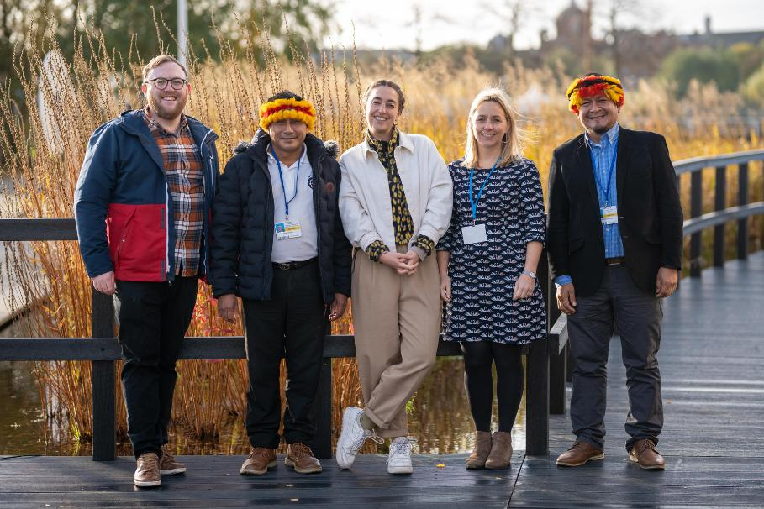
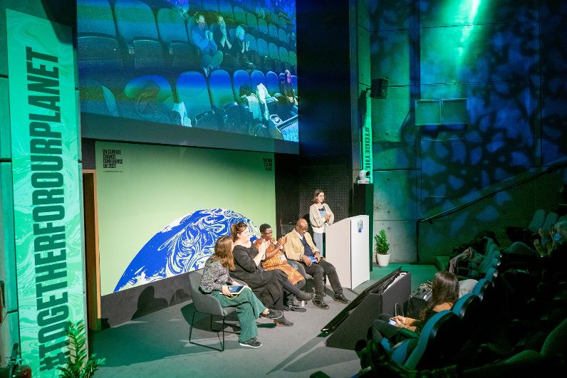
Size of Wales at COP26
Notes:
Size of Wales were very lucky to be invited to COP26 in 2021. Our staff and partners headed to Glasgow to join the many thousands of activists, Indigenous Peoples and organisations calling for climate justice.
Indigenous Peoples have been the guardians of tropical forests for millennia. To reach global climate commitments, we need their amazing conservation skills, and traditional knowledge, along with the unique ability of forests to store carbon.
Size of Wales staff worked with the Guarani People of the Atlantic Forest in Brazil and the Wampís of the Peruvian Amazon. Together, they engaged with global leaders and youth activists to tell stories of how climate change and deforestation is impacting them and their communities.

Slide 13


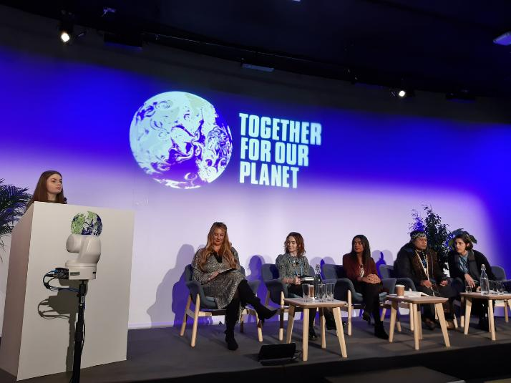
Representing young Welsh voices
Notes:
Video Link- https://www.youtube.com/watch?v=0ifn7qbrxeQ
The Youth Climate Ambassadors for Wales (YCA) made a powerful case for climate justice, including promoting the rights of Indigenous Peoples.
They met and engaged with a range of politicians. They not only discussed their own priorities but also spoke up about the inequalities of the conference and how oppressed voices weren’t being listened to.
Outside of the conference, the YCA took to the streets, joining tens of thousands of people on a Youth March on 5th November. This showed that young people across the world are united and determined to bring about change.

Slide 14



Amplifying Indigenous voices
Notes:
The Guarani People are facing being forced off their land as a result of soy farming. Rivelino Verá Popygua, Chief of the Guarani, campaigned tirelessly throughout COP, explaining how products bought in other parts of the world have devastating consequences for his people. Whilst speaking to BBC Wales, he explained how soy grown in the Guarani territories is used to make animal feed for the meat we later consume in Wales.

Slide 15


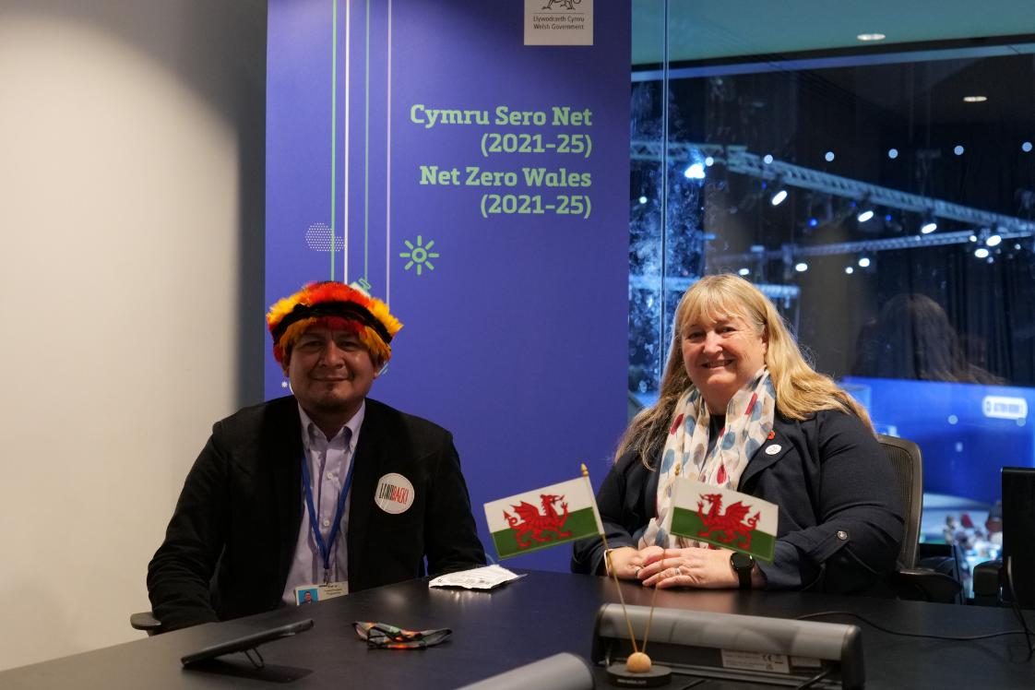
Welsh Government and The Wampís Nation
Notes:
In COP26 more than 100 leaders, including the UK, promised to end and reverse deforestation by 2030.
Julie James (Climate Change minister at the time) met with members of The Wampís Indigenous peoples.
She said she was determined to change Welsh government procurement policy to ensure they are not buying products linked to tropical deforestation.
Figures suggest almost 20% of the Amazon rainforest has been lost and, if another 5% goes, a tipping point could be triggered where it will not be able to sustain itself as a tropical rainforest.
In an interview with the BBC she said
"We absolutely have to do something to diminish and hopefully eliminate our footprint abroad as well as at home."
"We will also need to talk to all of our supermarkets and other purchasers across Wales to get everybody on board," she said.
Ms James said she had met with members of Peru's indigenous Wampis people at the conference.
"They were telling me about the destruction of their native lands, the deforestation, completely unintended by people who don't really understand what they're buying," she said.
Changing climate change targets, she said, was something the Welsh government was "determined to do".

Slide 16

Why is COP31 important?
  Leaders will discuss how to fulfill the Paris agreement of 2015. This states that we must limit the warming of our planet to 1.5 degrees celsius by the end of the century.
  Negotiators will need to significantly increase the total amount of money available to tackle the climate crisis.
  There is an urgent need for strong commitment to tackle the climate crisis and channel funding to countries from the global south, who are most vulnerable to climate change and have done the least to cause it.
Notes:
The Paris Climate Agreement is an international treaty that commits most of the world’s governments to addressing climate change.
It was agreed in Paris at COP21 in 2015 and the main goal of the Paris Agreement is to stop the world’s average temperature rising more than 1.5ºC.
Doing this would likely prevent the worst impacts of climate change (although it will still cause serious harm, especially to people who did least to cause this crisis). However, at the moment the world is not on track to meet this target.
Almost every government in the world has signed up to the Paris Agreement.

Slide 17

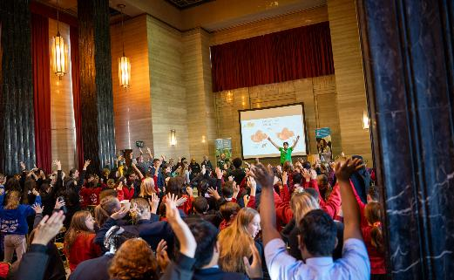
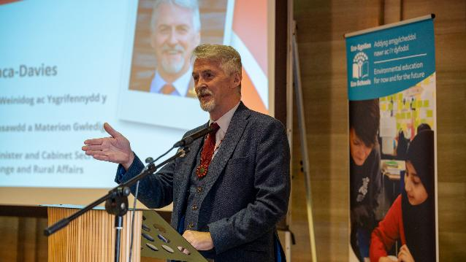
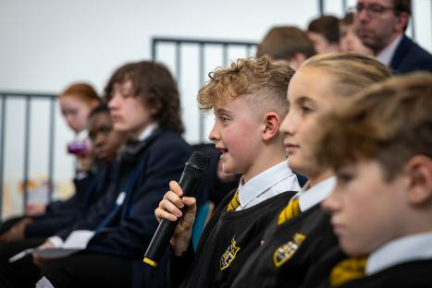
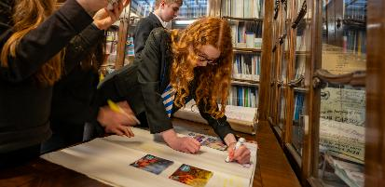
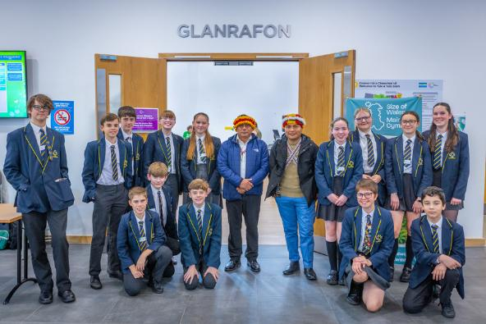
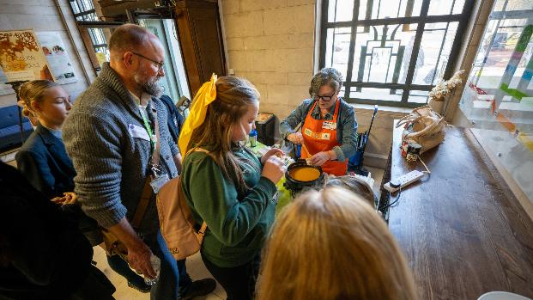
What is Youth Cop?
  Youth COP events are held around the same time as the COP Summit. This year Size of Wales are hosting Youth Cops in Wrexsam and Cardiff.
  The events provide a fantastic platform for young people to learn about climate change and gain skills like negotiating, problem-solving and understanding other cultures.
  Young people are encouraged to become more engaged with climate change, considering the positive role Wales can play, both locally and globally.

Slide 18

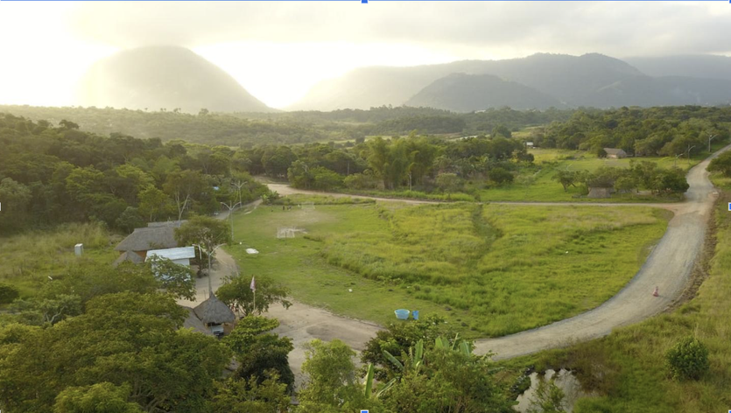
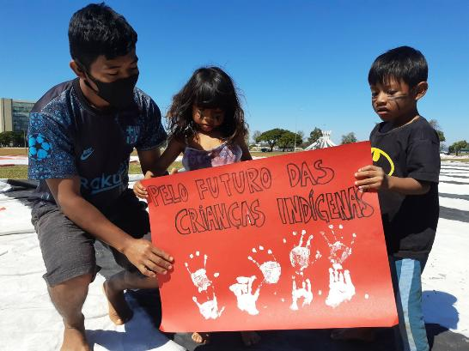
The Guarani attending Youth COP Cymru
Their forest is being deforested. They are fighting for their lands rights.
The Guarani are the largest group of Indigenous Peoples in Latin America.
They live in Brazil in the Atlantic Forest. Sadly, only 7% of this forest now remains.
Notes:
We are delighted to announce that the Guarani will be attending COP30 in Brazil. They'll be sharing the challenges they face with the world and demanding action. They will be joined by our deputy director, Barbara.
At Size of Wales, we have the privilege of working with the Guarani to help strengthen their legal lands rights, raise their voice and protect their forest.
You'll learn more about the Guarani in our resource 'The Guarani'. You will be able to send in any questions you have for them.

Slide 19


Wales and the Guarani; Together for tomorrow
This year, the Guarani will be attending our Youth COP event. Our theme ‘together for tomorrow’ will allow learners to come together to imagine a better ‘tomorrow’ for all, focusing on the Guarani.
Young people attending will have the opportunity to:
  Send the Guarani questions about their way of life and the challenges they face.
  Meet members of the Senedd
  Get involved in key discussions with stakeholders
  Be inspired by speakers who are taking action on deforestation.
They will take part in interactive workshops which will equip them with the skills and knowledge needed to take action in their school and community.

Slide 20

Learning check
  What is COP?
  Where is COP31 taking place?
  What is the Paris agreement?
  What are the main themes being discussed?
  How many countries are taking part?
  Which Indigenous Peoples are attending Youth Cop? Where are they from?

