Slide 1





COFFEE
Assembly Planner

Slide 2



WHAT MAKES A GOOD CUP OF COFFEE?
Introductory slide: You could begin your assembly by asking this question and going on to explain what “good” coffee means.
It could be the taste or the quality of the beans, but you want to get across that a Fairtrade coffee is the real reason that coffee can be the force for good.

Slide 3







AN EXCITING OPENING!
Every speech or presentation needs an exciting opening, something unusual, something that makes your audience sit up and listen! Choose from one of our suggestions or think of your own!
Well, what does make a good cup of coffee?
How about telling the story of coffee? Teach your audience how coffee was first discovered or what people thought of this mysterious drink when it first arrived in Europe.
Think of a surprising or shocking fact related to coffee, for example: How much rainforest do you think might be lost in the time it takes to make a cup of coffee?'
Tip! Bring your words to life with film and images and try not to use any text on your slides.
Take a look at some experiments on YouTube…your audience of teachers would surely love a Barista Masterclass from you.

Slide 4












What else is found near the equator?
How does sustainable farming help coffee farmers?
Where is coffee grown and why is it grown there?
Inform your audience about coffee!
Can you tell the journey of coffee?
How does unsustainable coffee cause deforestation? Demonstrate this.
Why are tropical forests so important?
Which countries grow coffee?
Who grows the coffee?

Slide 5



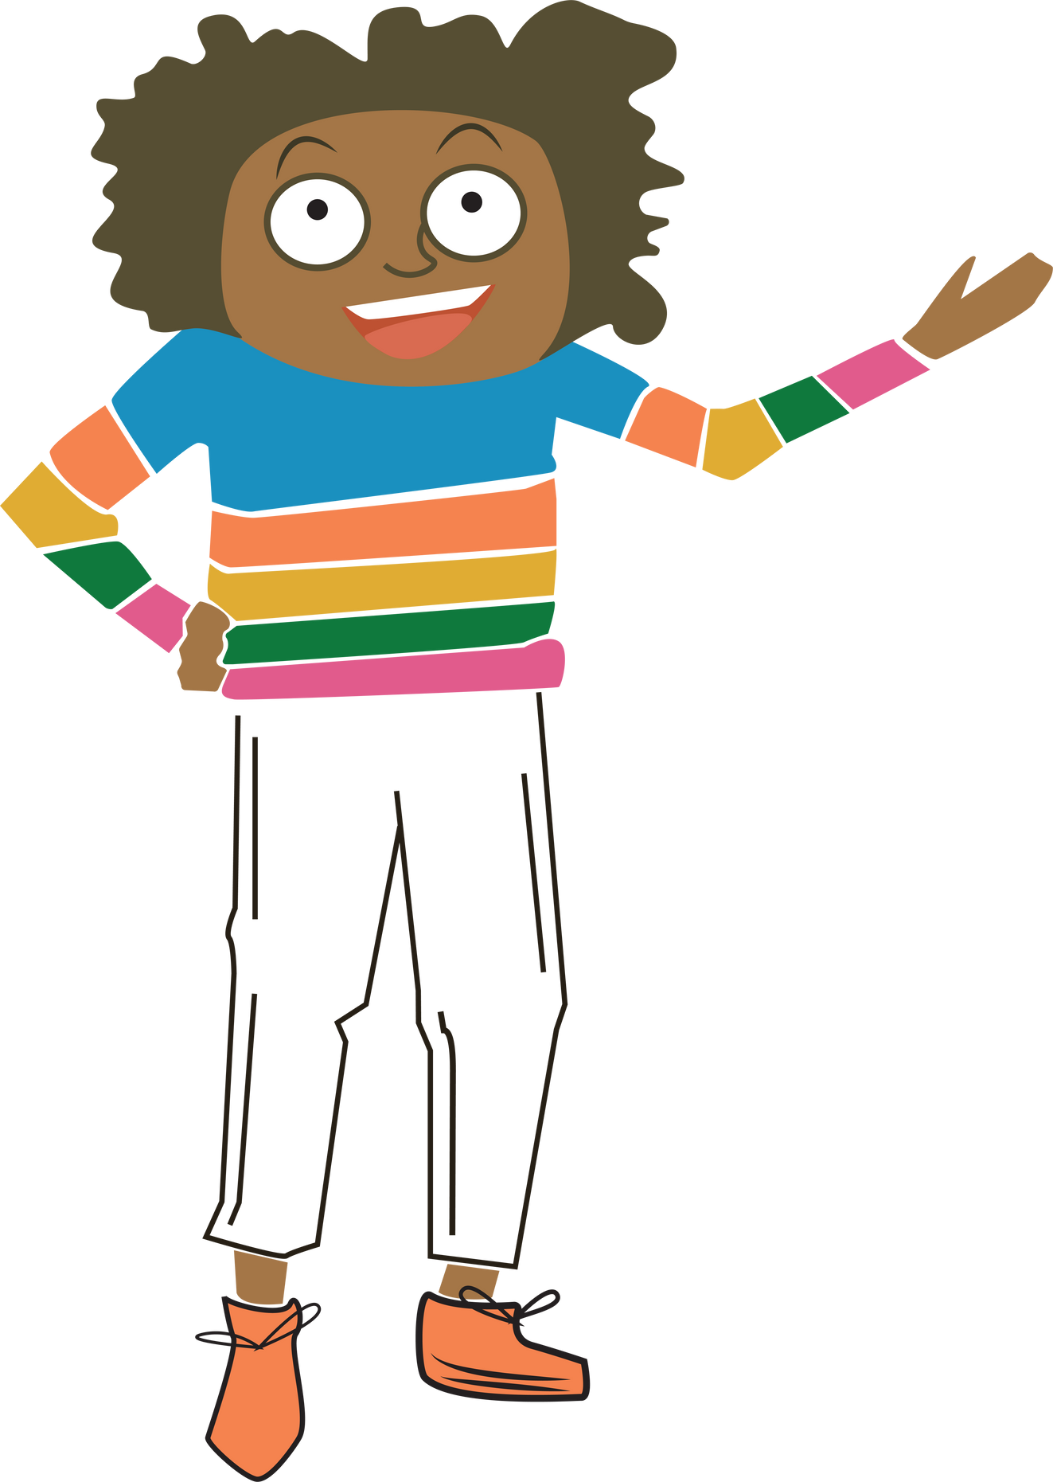


So, what is the solution?
What are the benefits:
For farmers
For customers
For forests
Explain Fairtrade and why it makes a “good” cup of coffee

Slide 6




If you want to persuade anyone to change their habits it is important to know why they behave in a certain way.
You could carry out a survey on the coffee habits of adults in your community!
Where do they buy their coffee?
Do they buy Fairtrade?
If not, why not?
Which brand do they buy?

Slide 7




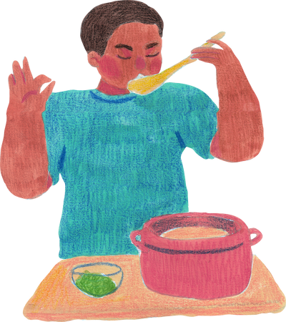
Results
Use graphs to help show the results of your study.
If cost was important did you find any Fairtrade brands that matched the cost of the teachers’ original brands?
Have a look at the link to Co-op’s honest value range. Our value with values range - Co-op (coop.co.uk)
Having tasted Fairtrade coffee are they now ready to take the pledge?
If taste was important then teachers should have the chance to taste a variety of brands. Maybe you can change their minds?
What could you invite them to test?
A cheap Fairtrade brand?
A mid range Fairtrade brand?
A high end (Jenipher’s coffee) Fairtrade brand?

Slide 8






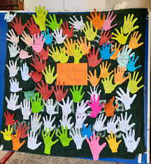










Create a pledge board
Get a good photo!
Share the pledges on social media
Inspire action!
Display in a public place as a reminder!
I pledge to use Fairtrade
Strike while the iron is hot and everyone is excited!
A public pledge board helps to build momentum.
I pledge to drink Fairtrade coffee
What will your pledge be?
Making Wales part of the solution!

