Slide 1


Climate Change:
The Basics

Slide 2
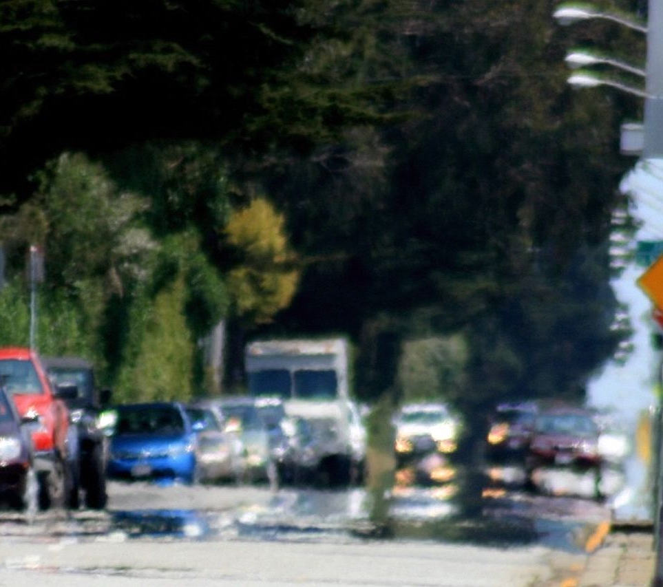
How the sun heats the planet
90% Short wave radiation
1% Short wave radiation
Short wave radiation
Short wave radiation
Long wave radiation
Long wave radiation
Ice
Tarmac
Notes:
So to outline the basics of climate change and how humans are driving it, we need to first cover some simple concepts.
The suns rays come to earth via what is called short wave radiation, meaning it is radiation that has a short wavelength. This wavelength allows it to pass through our atmosphere and hit the surface of the planet. Radiation and heat in this context are the same
Depending on how reflective the surface is, some of this radiation is absorbed and some is reflected back out to space.
How reflective a surface is, is called the albedo of the surface. But this just means how shiny it is. A mirror is more reflective than a tarmac road and so a tarmac road has a lower albedo!
Ice and snow is very reflective. Can you guess how much sunlight is reflected straight back into space by snow and ice? Click for answer 90% is reflected back to space
Tarmac on other hand is darker and so absorbs more radiation. How much more do you think it absorbs? Click for answer picture it absorbs 99% of the energy that hits it, meaning it absorbs 89% more than Ice.
So where do the rest of the sun’s rays go? Well they turn into long wave radiation that comes off of the surface at a later date. Have you ever seen the wavy heat lines coming off tarmac on a hot day? This is long wave radiation. sometimes you can even see this effect on roads on hot days with heat given off by the surface click for picture of heat haze

Slide 3

Long wave radiation
How long wave radiation heats the planet
Short wave radiation
Notes:
So the sun’s rays can pass through the atmosphere as short wave radiation without getting trapped. However, long wave radiation doesn’t escape so easily!
Click: Some long wave radiation makes it out of our atmosphere and into space, but lots of it gets trapped inside the atmosphere and bounces around heating the planet.

Slide 4
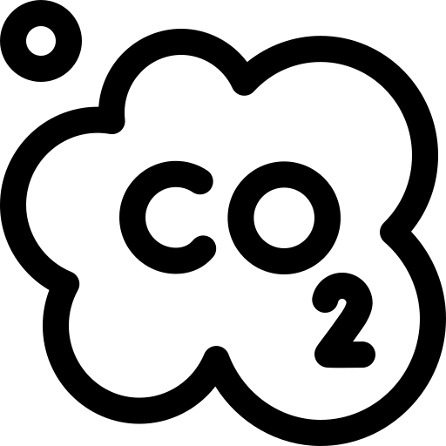
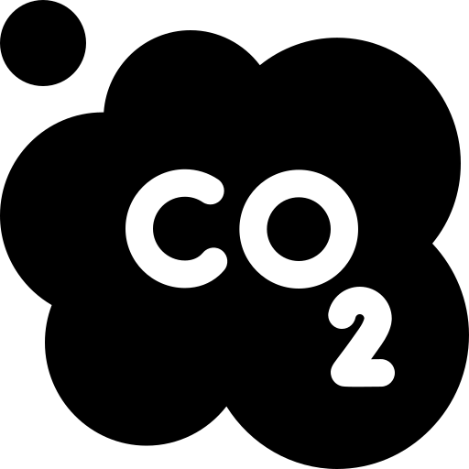

So why do green house gases matter?
Long wave radiation
Notes:
When the long wave radiation tries to leave the planet, it gets absorbed by particles in the atmosphere, including green house gases, it is then readmitted in all directions which traps it and begins to warm the atmosphere
There are many green house gases and the more there are in the atmosphere the more of this radiation gets trapped
The one you will hear the most about is carbon dioxide, but there are others like methane that also trap this heat.

Slide 5



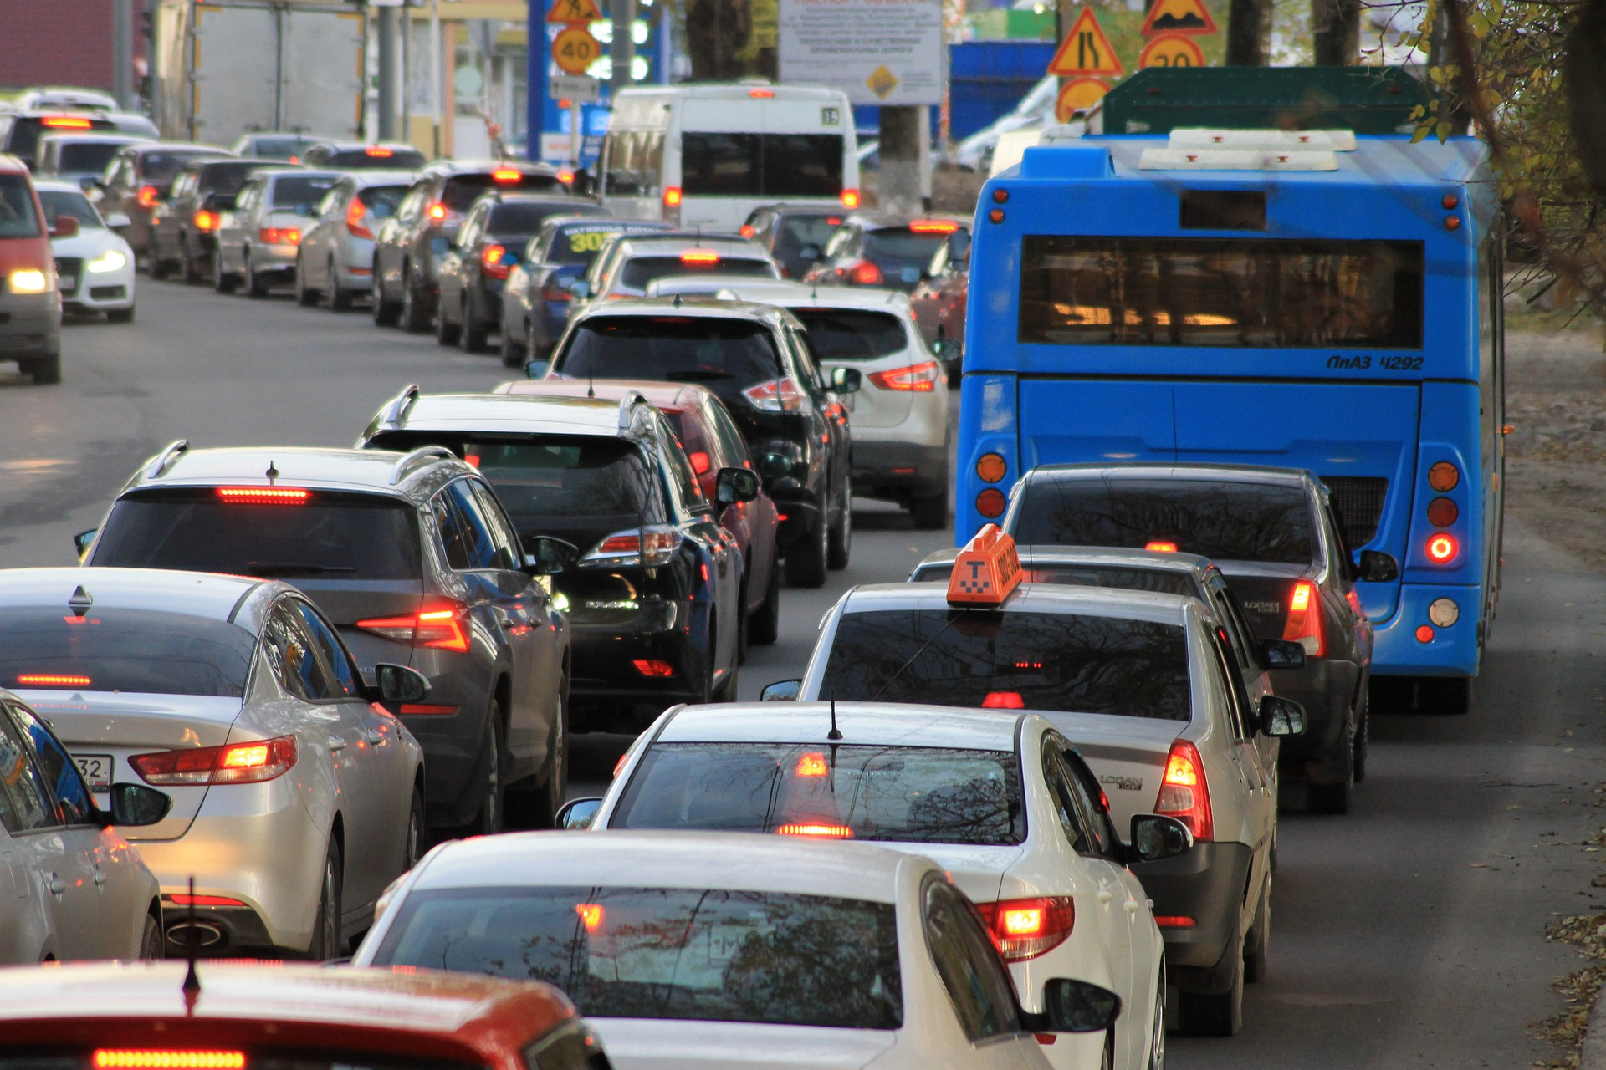
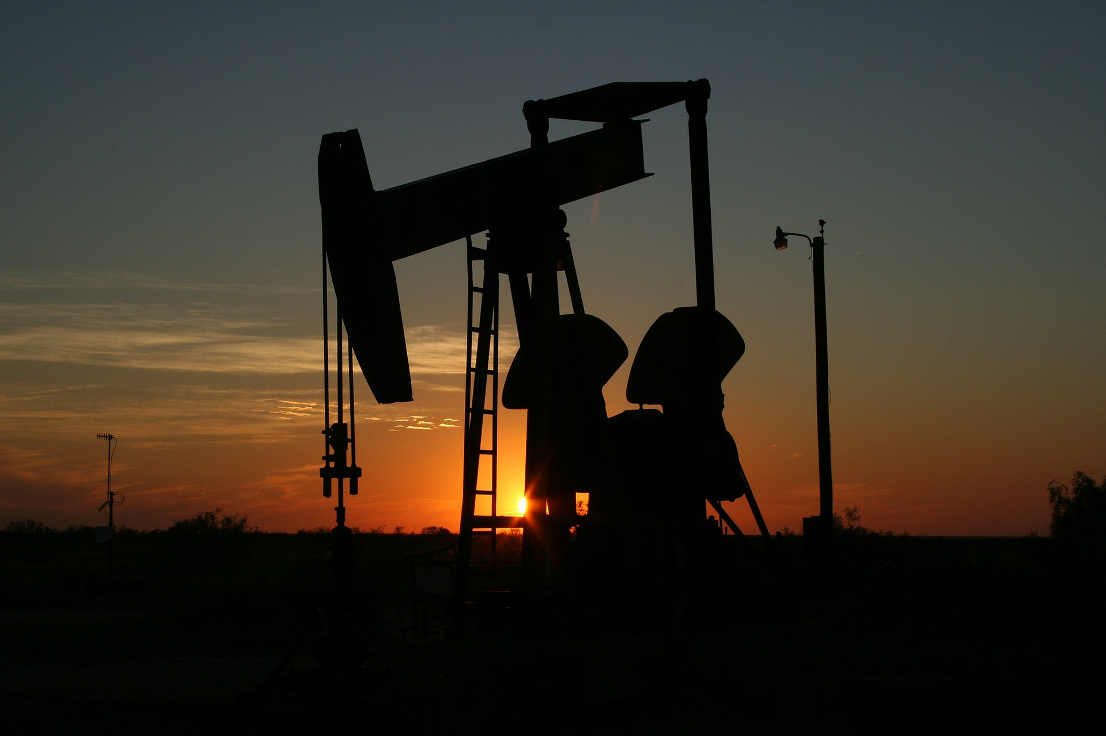




How do humans increase green house gases?
Coal, gas and oil has carbon stored in it
Which is used to generate electricity and heat
And used to power our modes of transport
But we don’t just burn fossil fuels
Notes:
Human activity increases the amount of co2 and other green house gases in a number of ways
Click: Firstly we take fossil fuels out of the ground, which is carbon stored millions of years ago, when biological material such as plants and dinosaurs became trapped underground and we take these carbon stores and we burn them.
Click: to release heat to drive turbines to generate electivity, heat and power our transport.
When you burn things they give off CO2

Slide 6






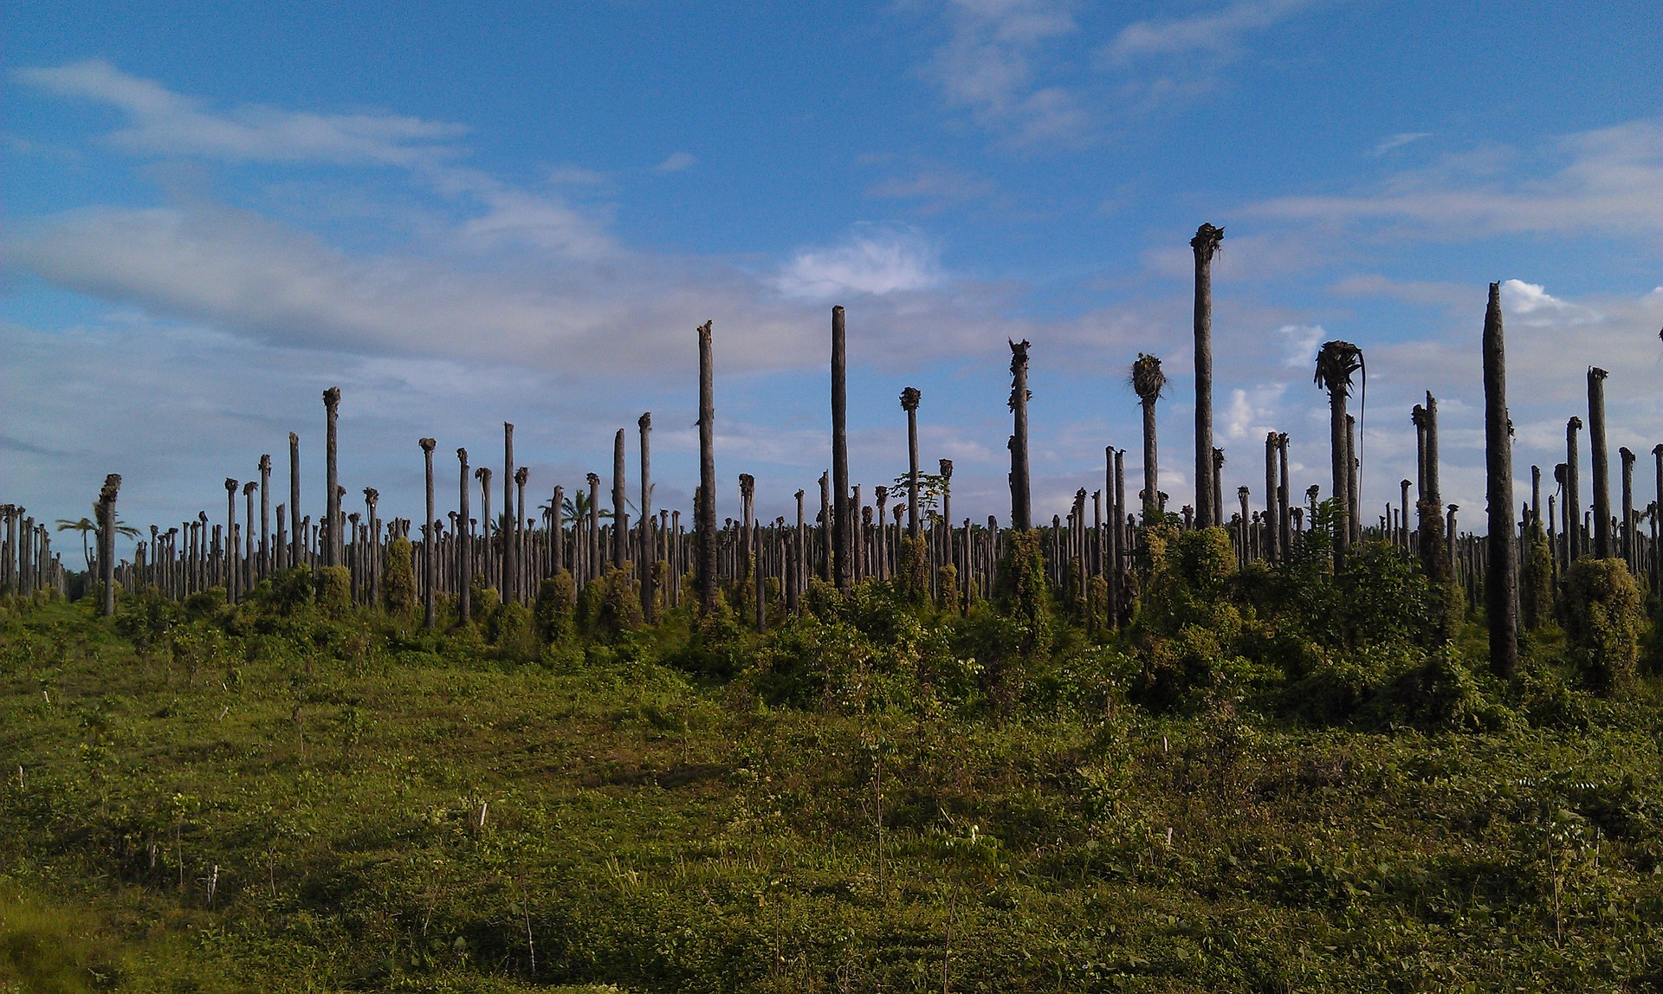

Farming is one of the larger drivers of climate change
Notes:
Humans also do other things that contribute to greenhouse gases increase .
For example our farming drives climate change.
Trees absorb co2 from the atmosphere and lock it up, in photosynthesis
Click: when we cut them down, this co2 gets released back into the atmosphere if we burn them or leaves them to rot, this therefore is another carbon store we are removing and adding to the atmosphere
This is taking place around the world and especially in tropical forests.
This is driven by mostly a handful of commodities,
Click: which includes beef, palm oil which is found in all sorts of things from peanut butter to chocolate and cleaning products, soy which is mostly used to feed animals that we then eat, chocolate and coffee.
While cutting down forests is bad for a whole host of reasons such as animals losing their homes, there are other reasons why climate change is bad

Slide 7










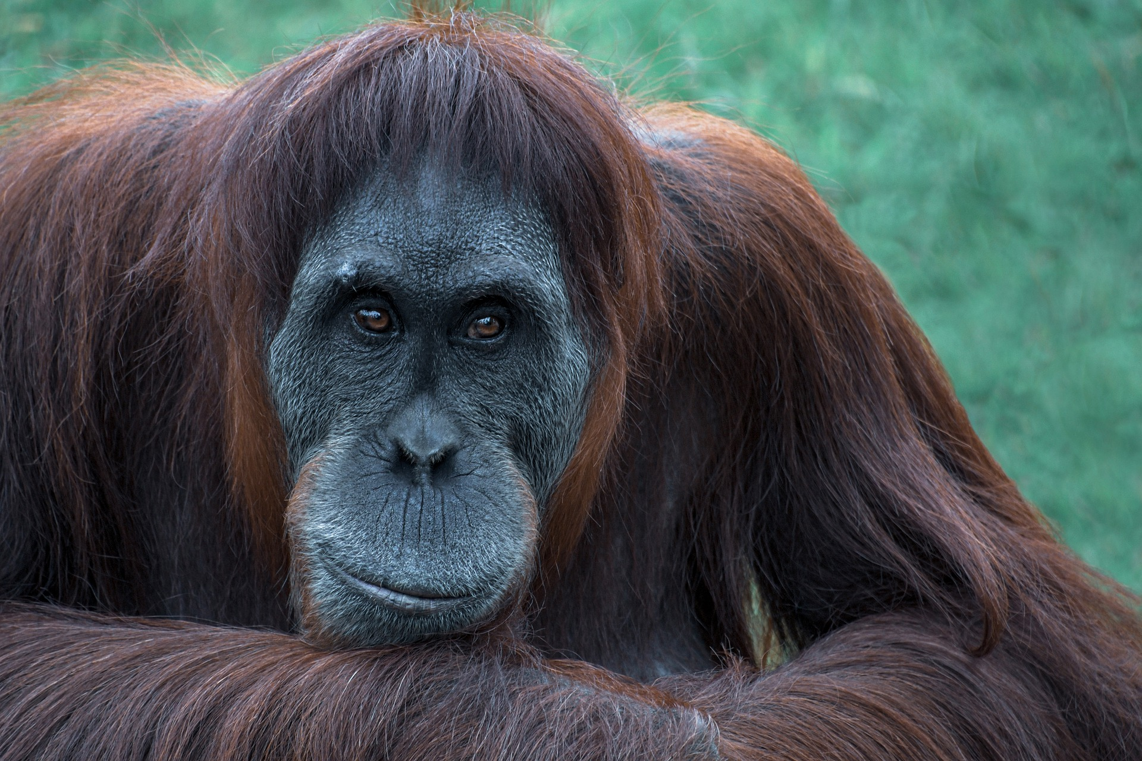


Why does this matter?
Notes:
As the earth begins to warm
Click: there are predictions for how this will impact things and some of these are already being seen today
Click: This includes sea levels rising due to land ice melting from hotter temperatures (run experiment 2)
Click: Some parts of the world may become so hot that people will not be able to live there. Recently Iran faced temperatures of 52⁰c for example meaning people will need to move
Click: We should expect more extreme weather events, including heat waves, more storms and more powerful storms, droughts that can lead to devastating wild fires like those seen in Australia in 2020.
Click: Many animal species will simply become extinct as the climate where they live changes
And these are just a few ways it can negatively impact our world

Slide 8

Protect and replant our forests
So what can be done to change this?
Replace fossil fuels with renewables
Eat less meat
Walk, cycle or use public transport
Waste less food
(food waste accounts for 10% of all emissions!)
Notes:
But we can change this and prevent these things from happening.
There are many things we can do, but some of the ones that are the most important for people are:
Click: Protect our forests; they are carbon stores that continue to remove the carbon we are putting up into the atmosphere. If we plant more trees in the right places we could even begin to draw down some of the carbon we have put into the atmosphere
Click: If we stop using fossil fuels to generate our energy and fuel our means to get around we can stop adding to the problem
Click: By eating less meat, we reduce the amount of land needed for crops and can return this land to forests and other habitats that store carbon,
Click: Reducing our need for transport that burns fossil fuels is a good way to reduce one of the largest sectors for emissions
Click: Food waste is a huge issue and is responsible for 10% of emissions
Can you think of what we can do?

Slide 9
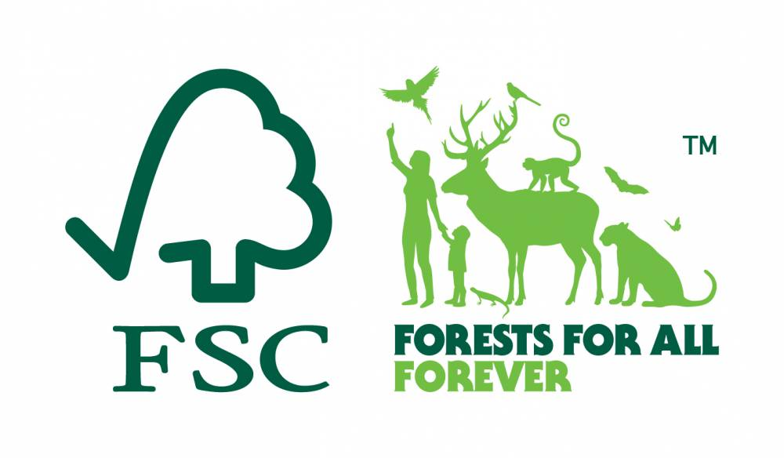



Buy Welsh Grass fed or organic meat and animal products
What you can do?
Buy sustainable palm oil
Buy only fairtrade chocolate and coffee
Buy FSC certified paper
Notes:
What you can do
Click: By buying locally produced meat you avoid meat that is reared on land that was rainforests
Click: look out for sustainable palm oil logos
Click: Fairtrade is the way to go for chocolate and coffee
Click: FSC certificed paper means it comes from sustainable and renewable forests.

